Slide 1
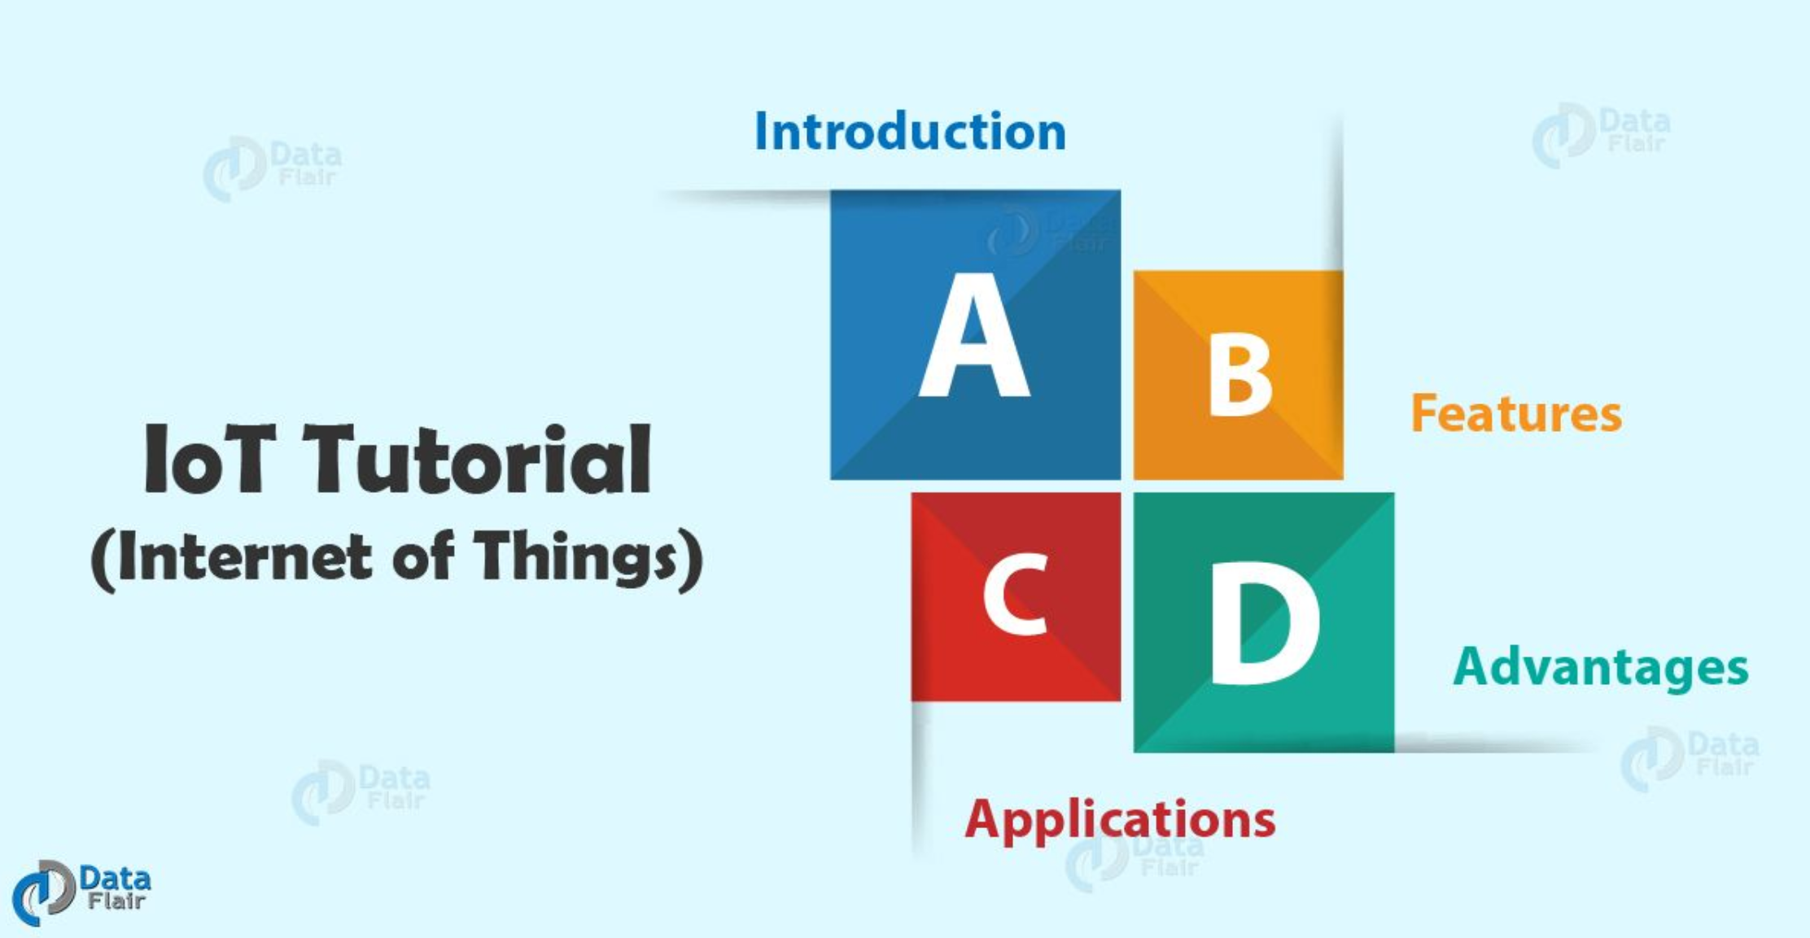

Slide 2
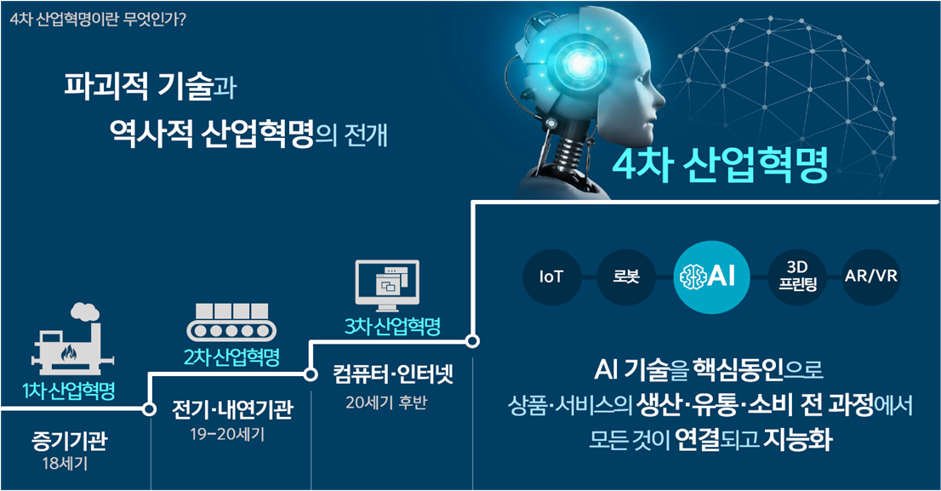

Slide 3
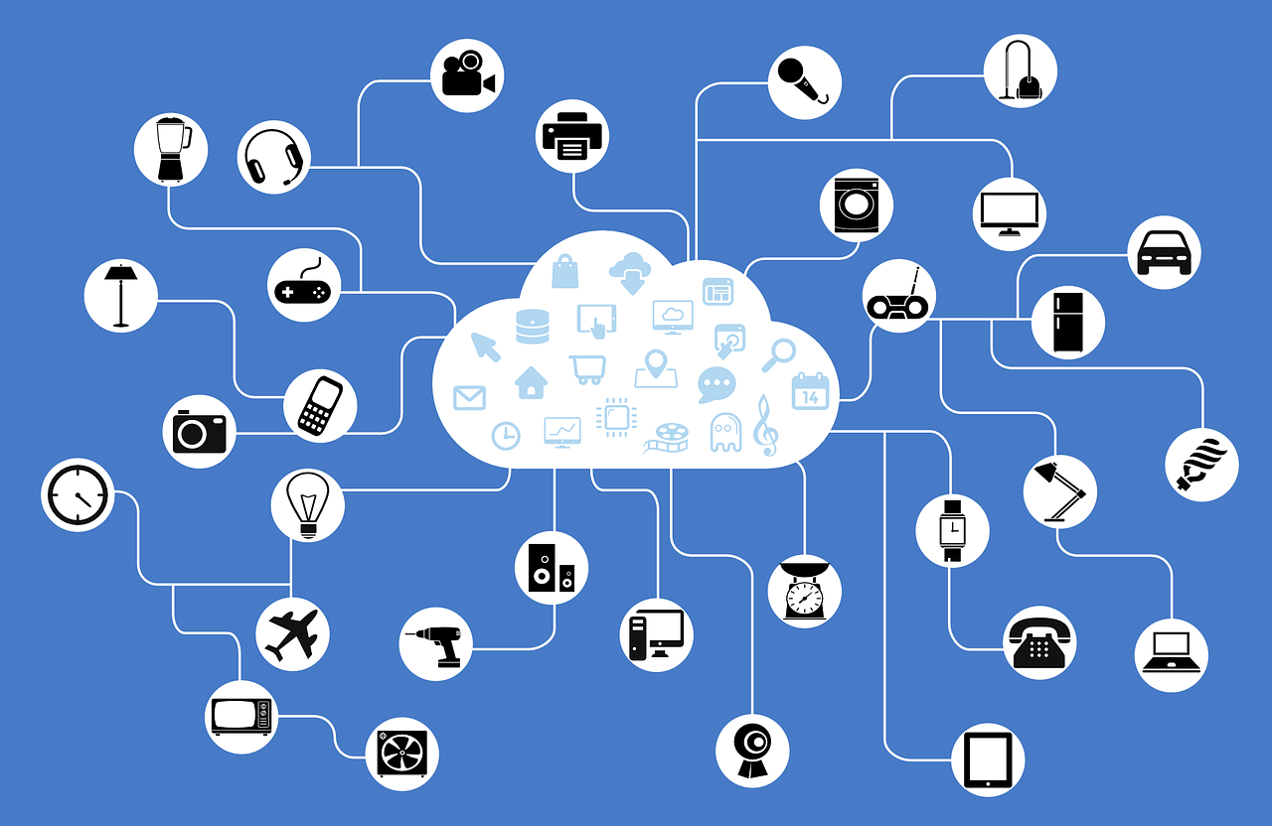
IoT (cf. IoE, IoST, WoT,…)

Slide 4


스마트 홈 (SKT 사례)
IoT 서비스 사례: Smart Home (SKT)

Slide 5
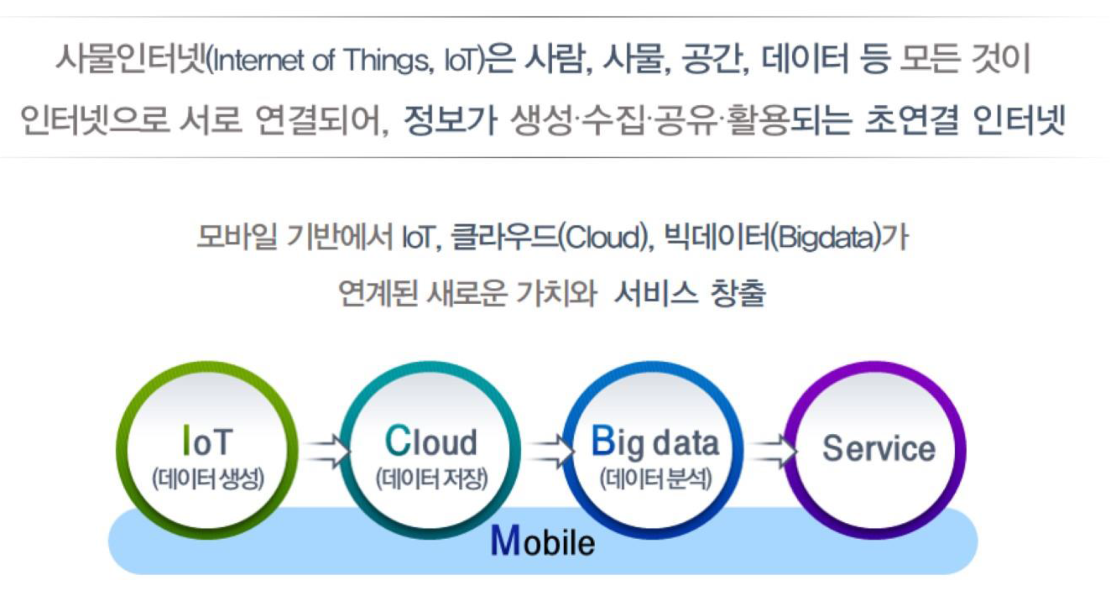
IoT Overview

Slide 6
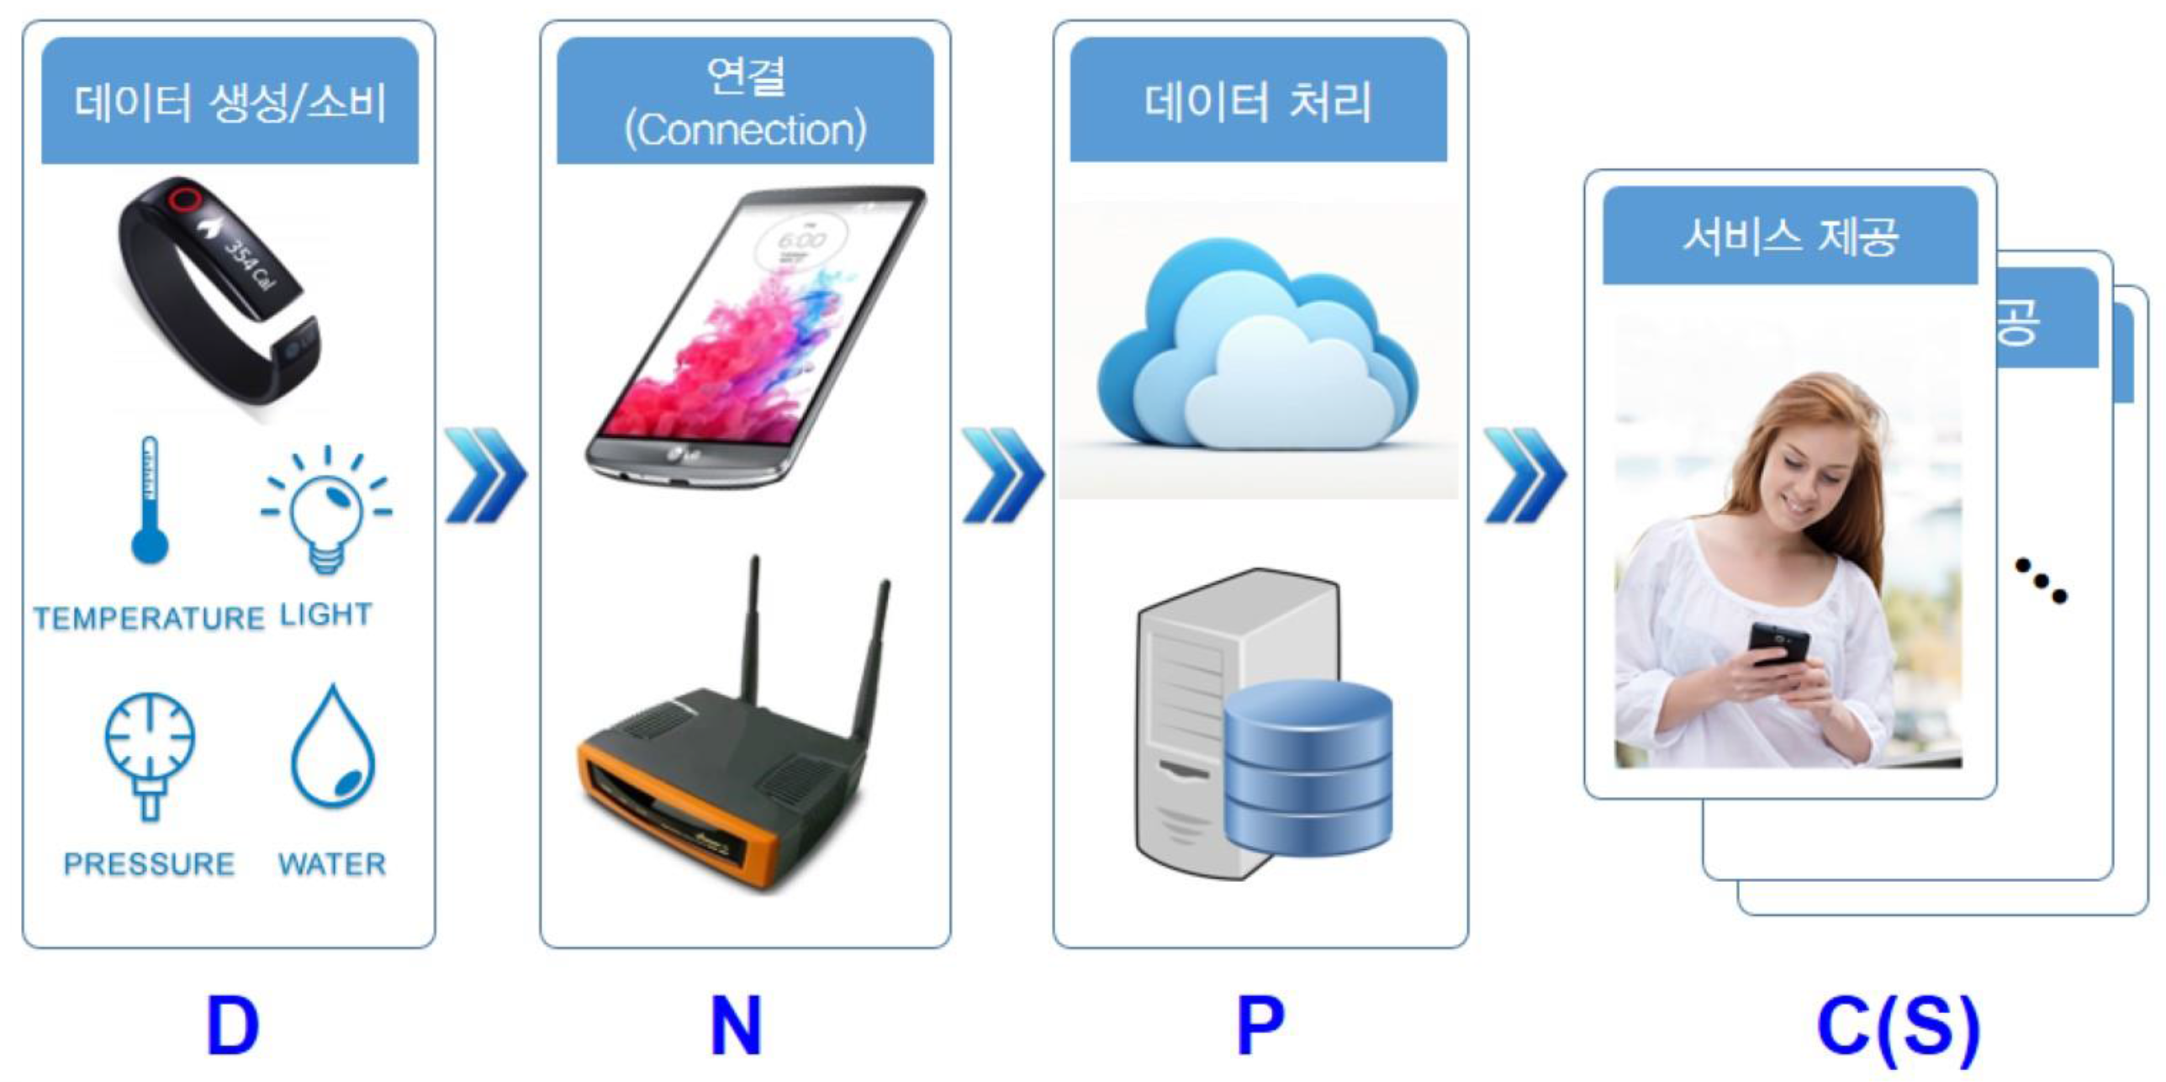
IoT Overview

Slide 7
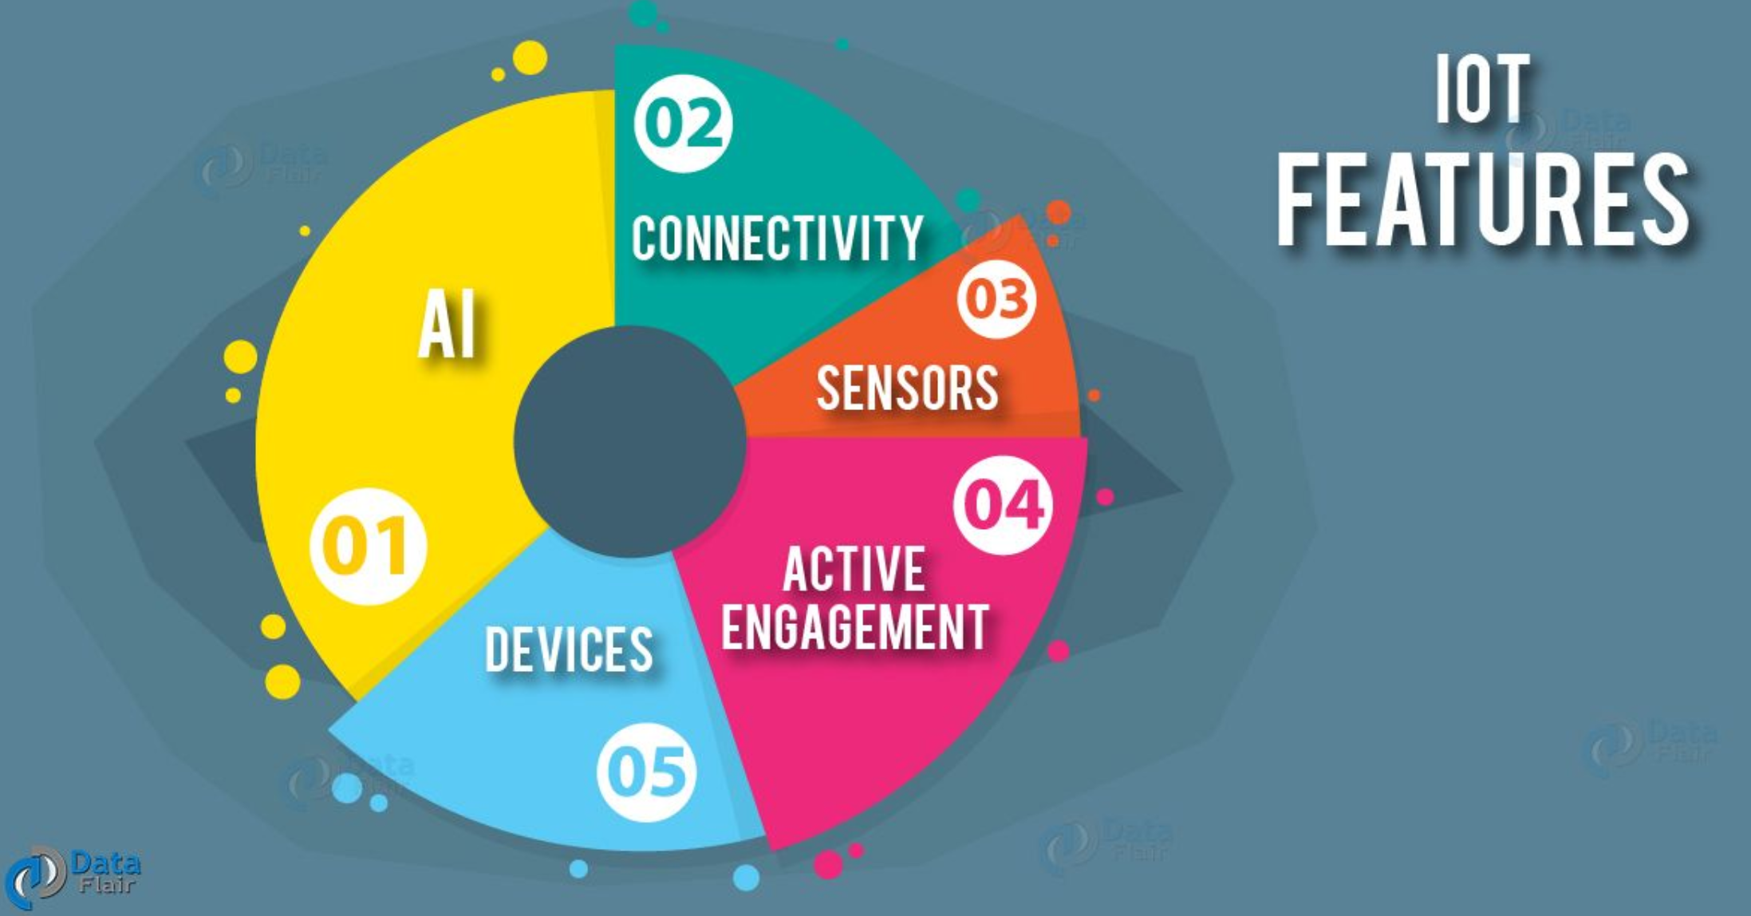

Slide 8
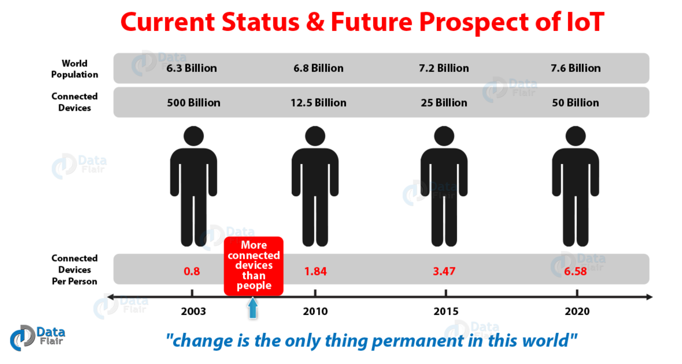

Slide 9
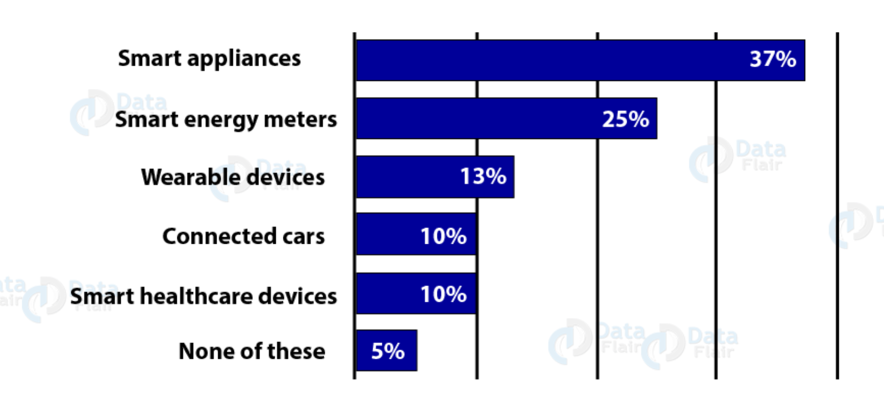
IoT Applications

Slide 10
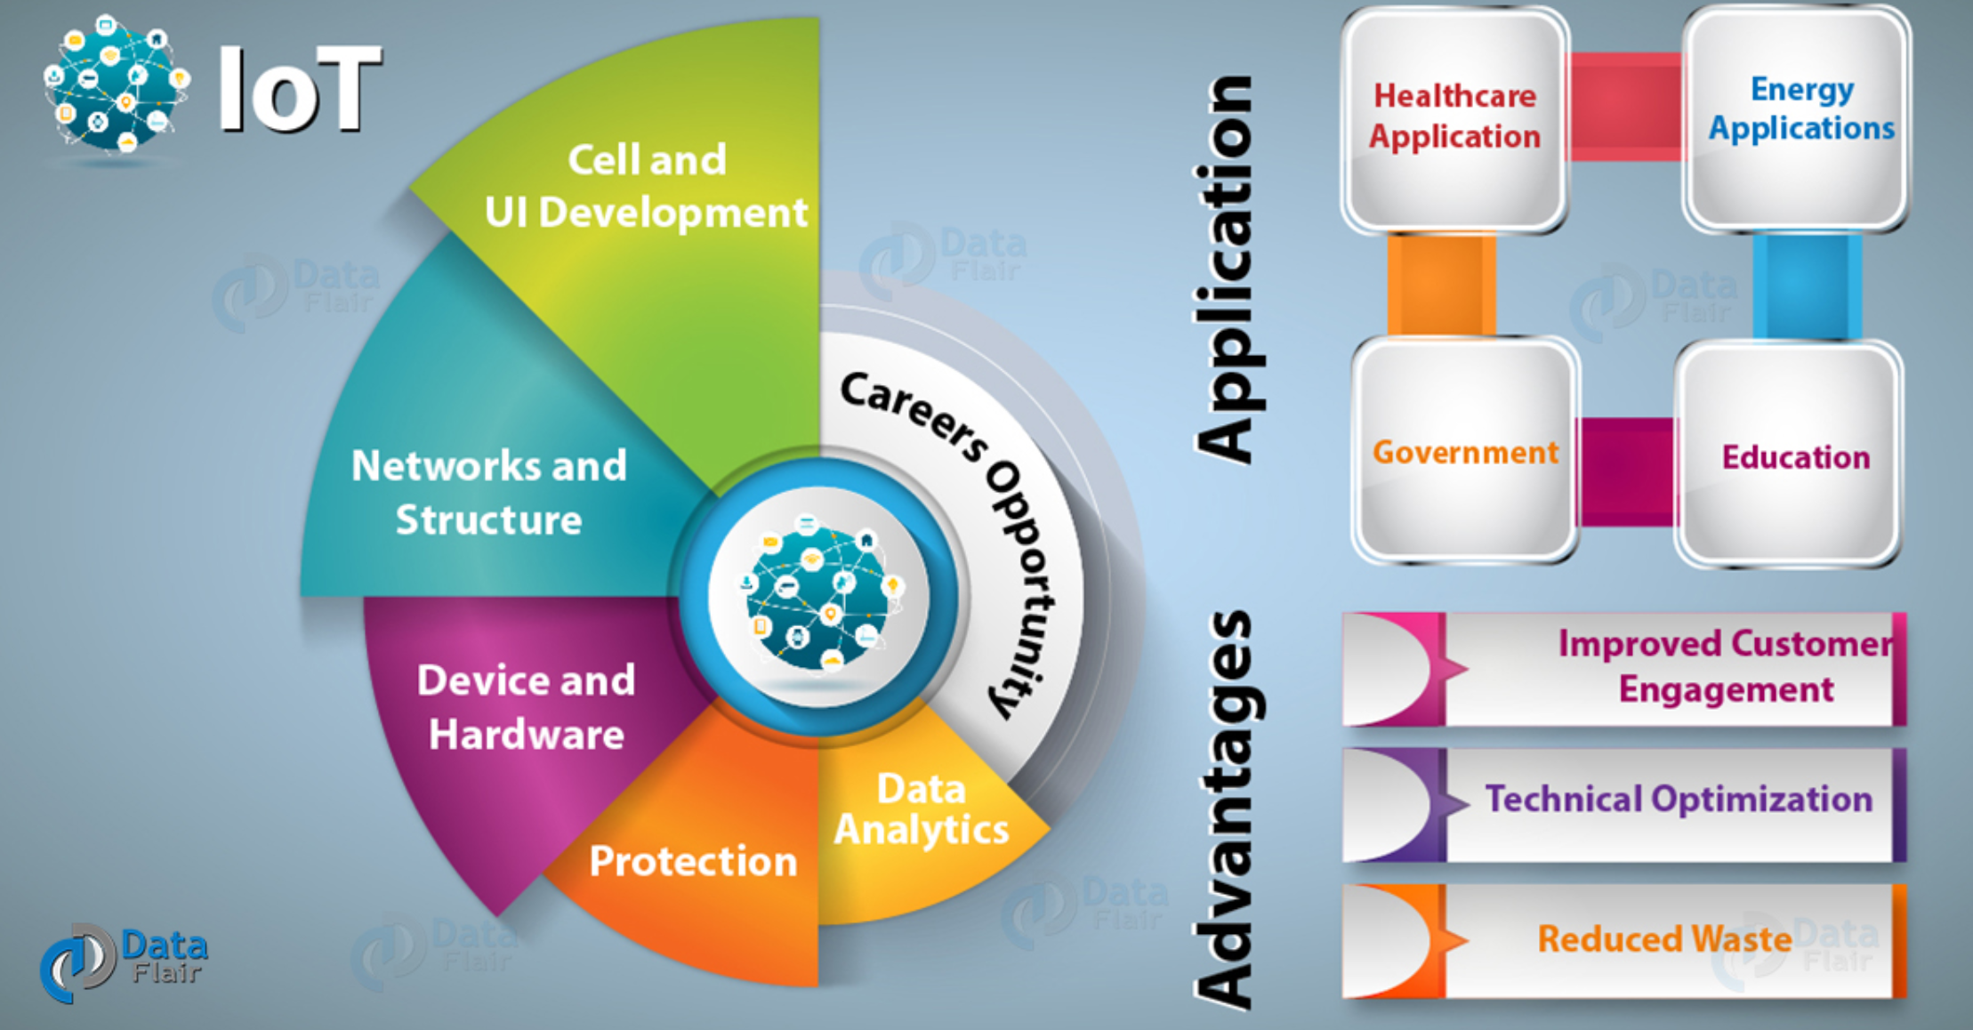
Advantages of IoT

Slide 11
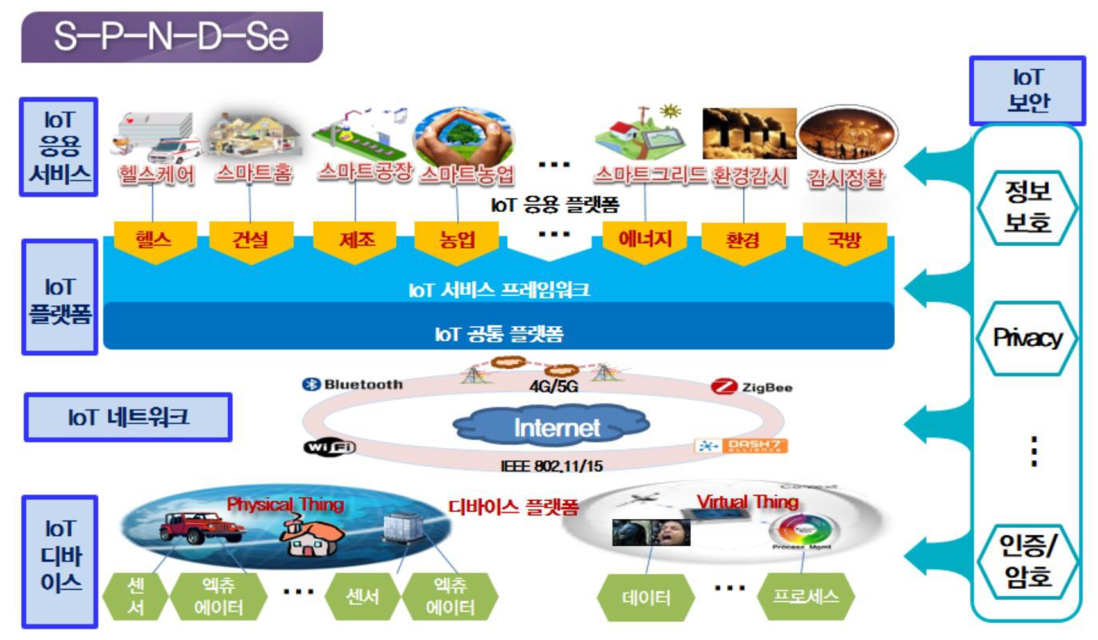
IoT Service Architecture

Slide 12
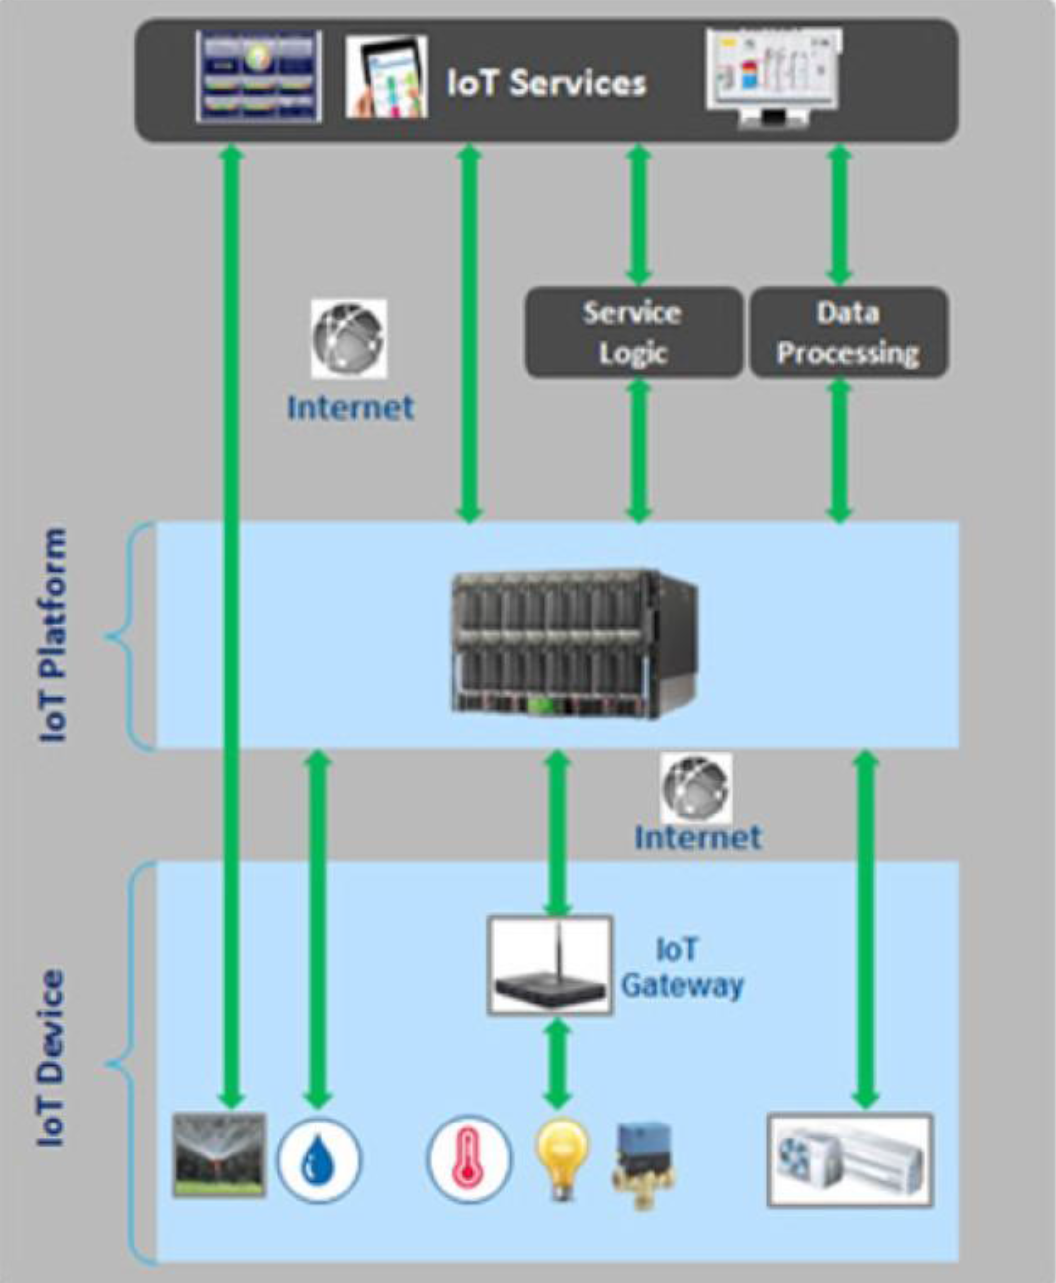
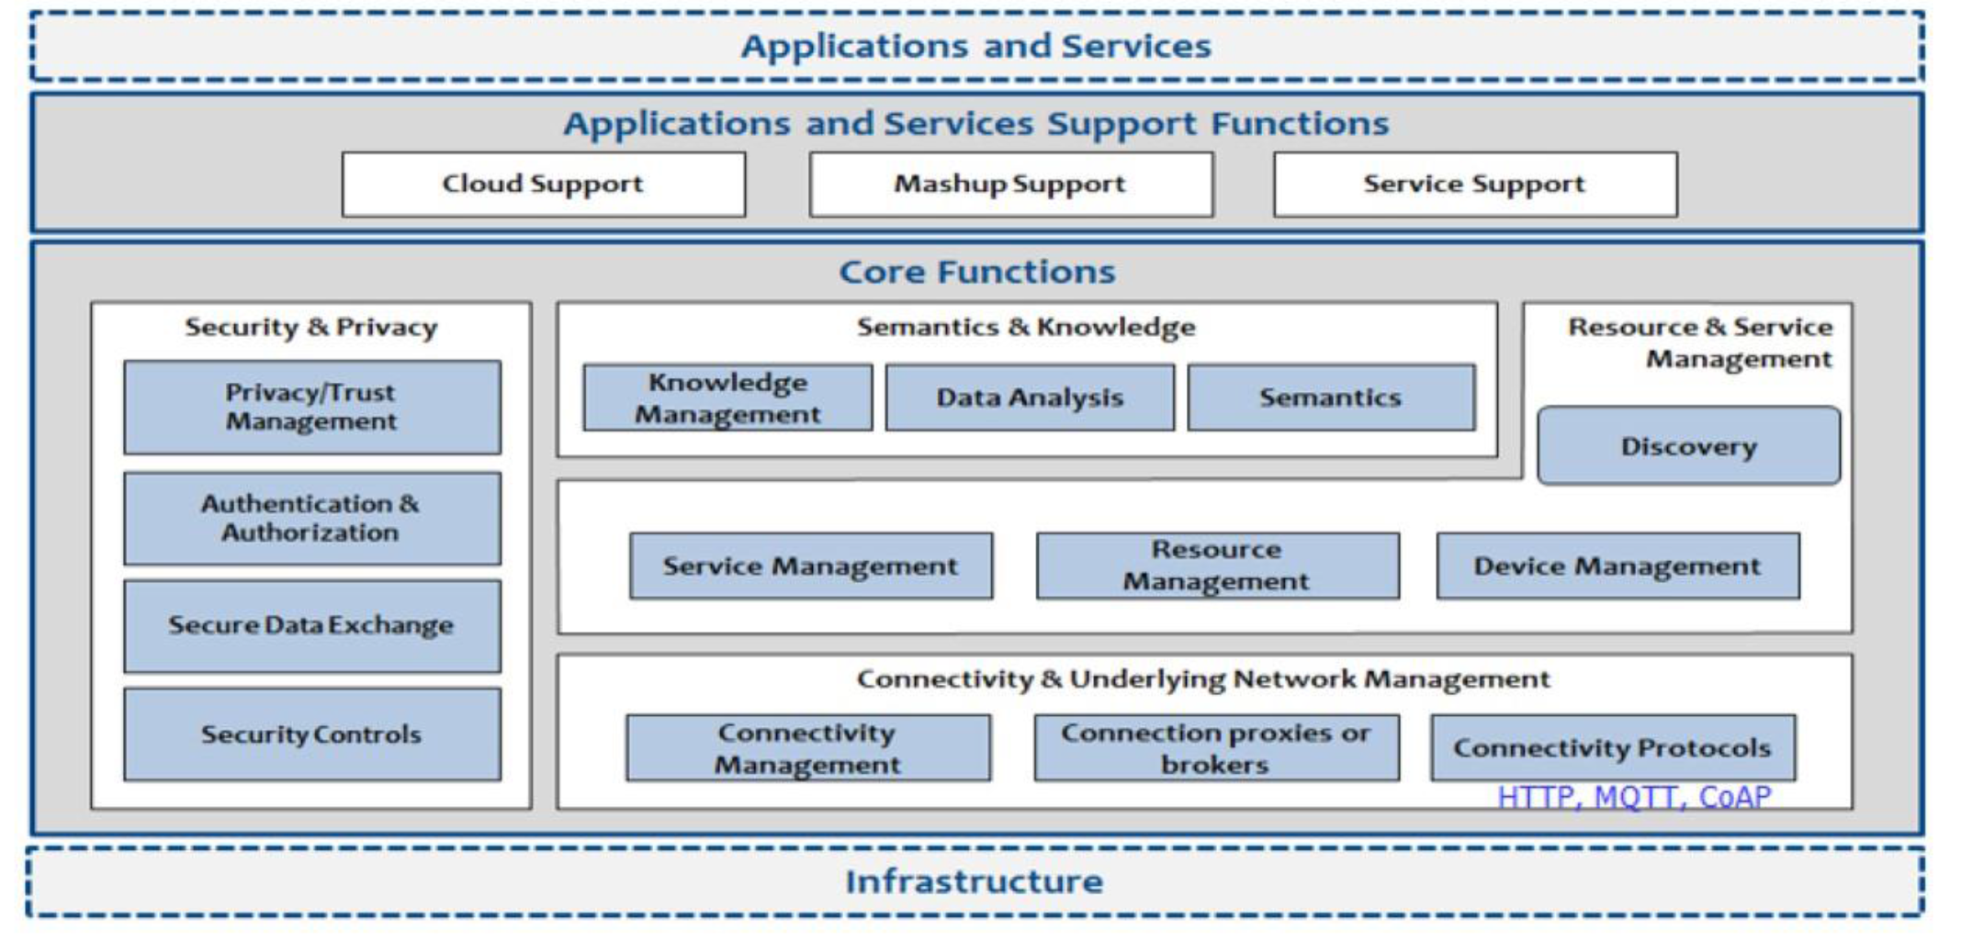
IoT Platform

Slide 13
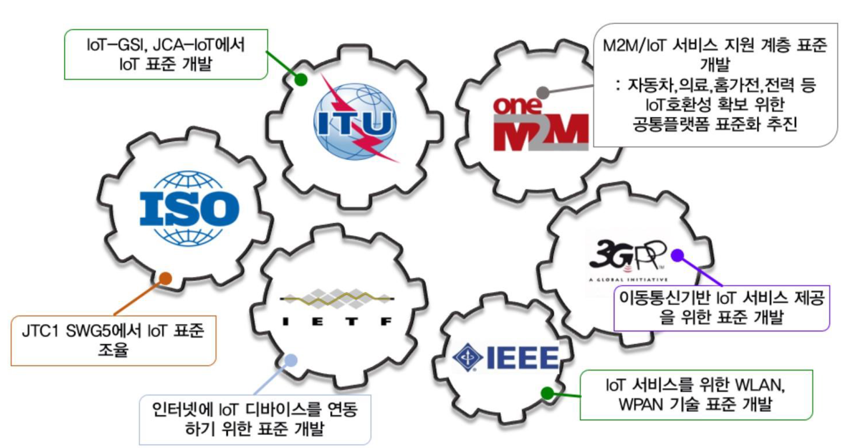
IoT Standards

Slide 14
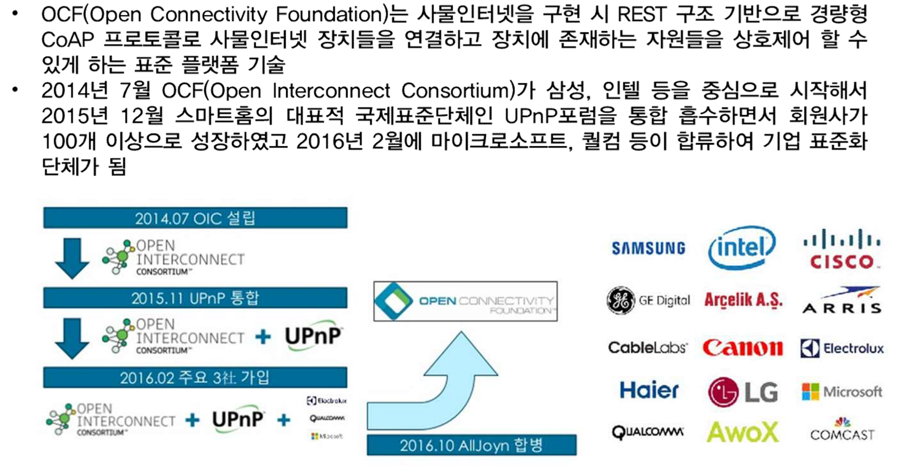
IoT Standards: OCF

Slide 15
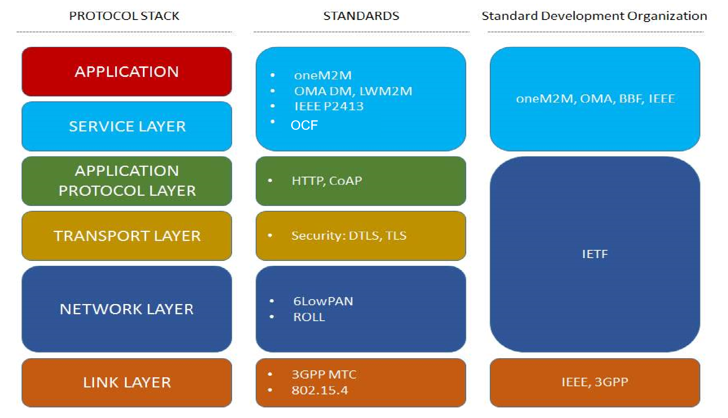
IoT Standards: 표준화 영역

Slide 16
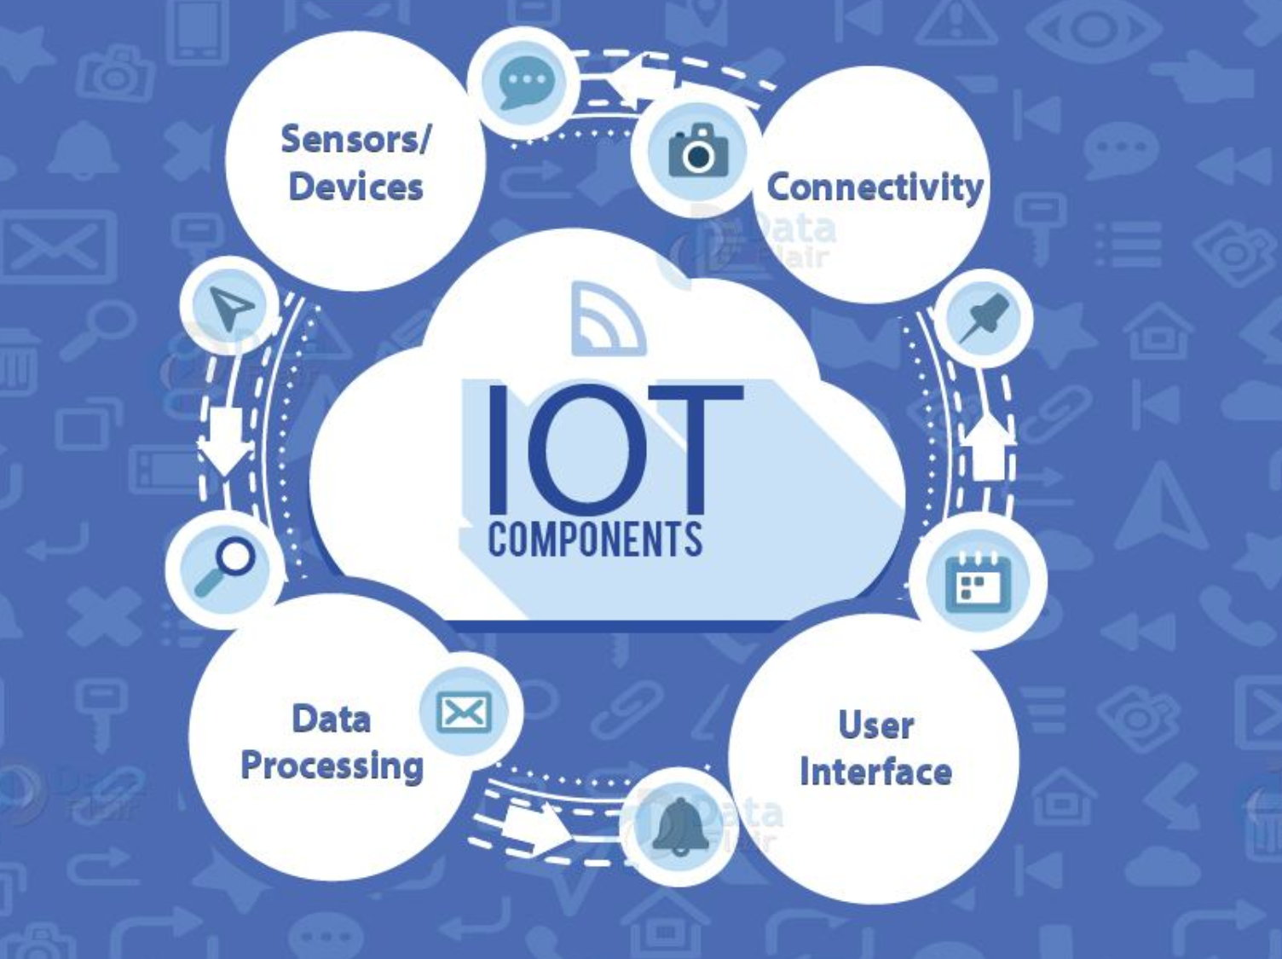
IoT Components

Slide 17
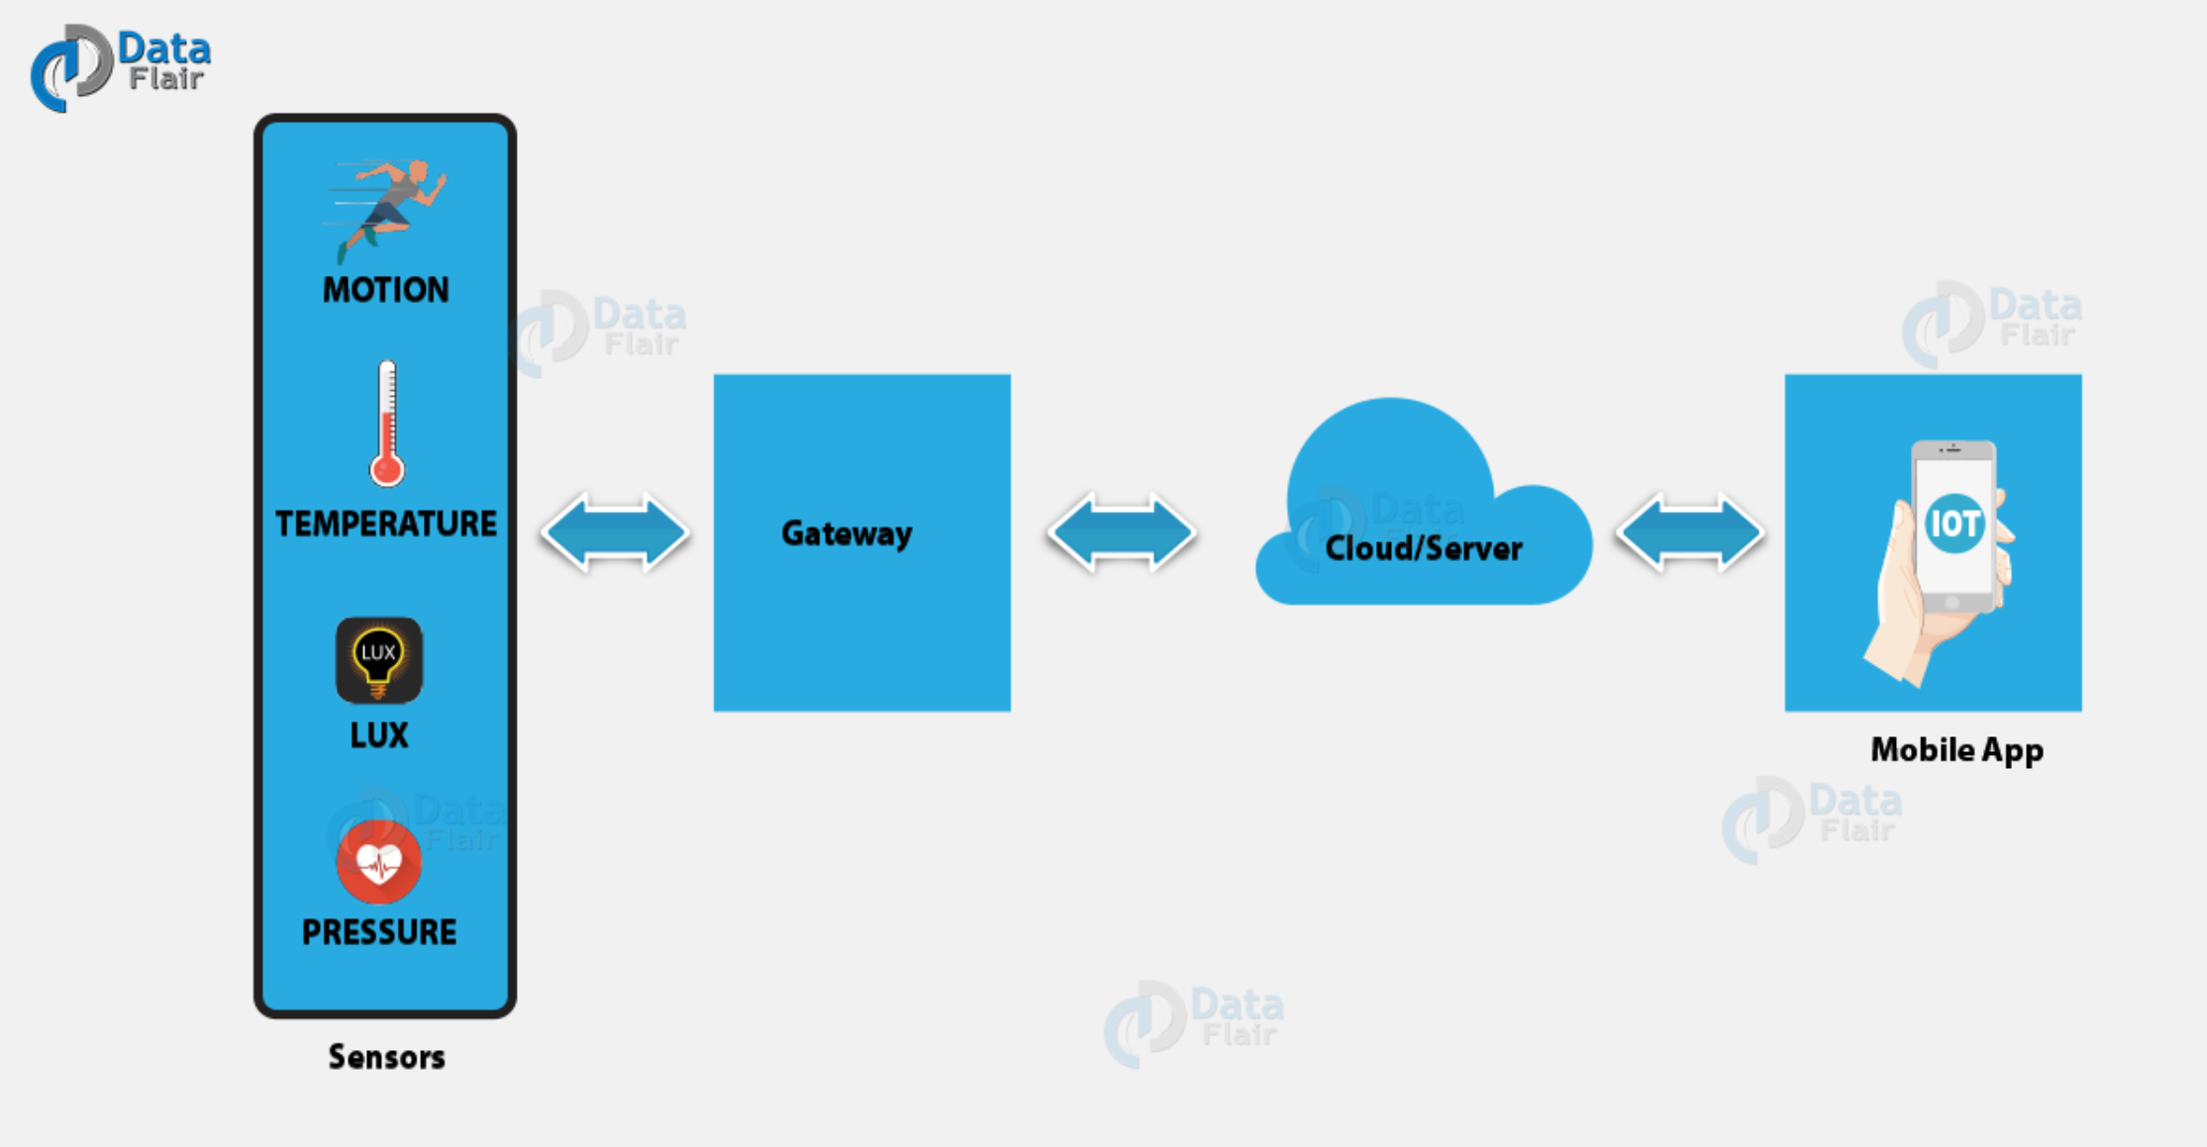
How IoT works ?

Slide 18
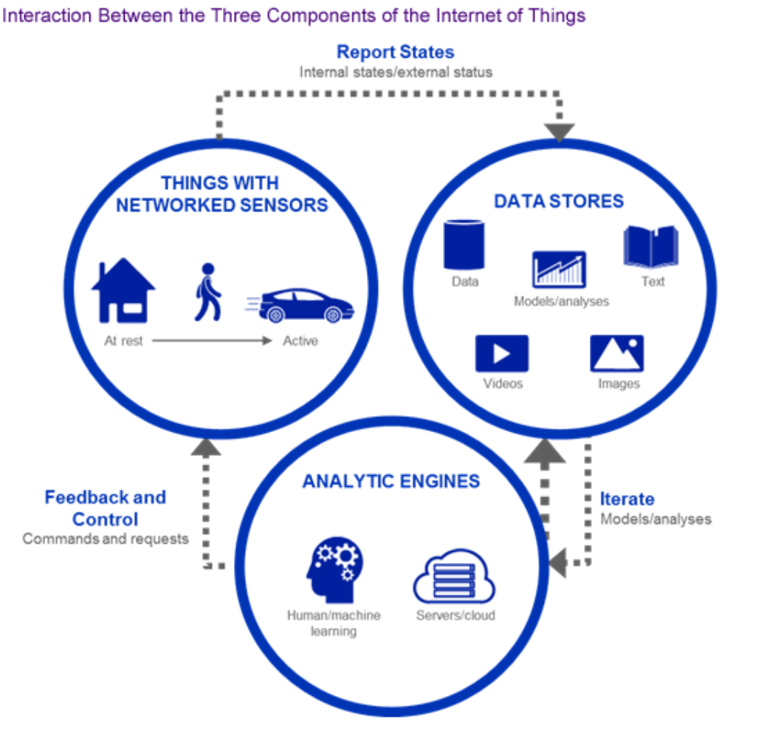
Data Processing

Slide 19
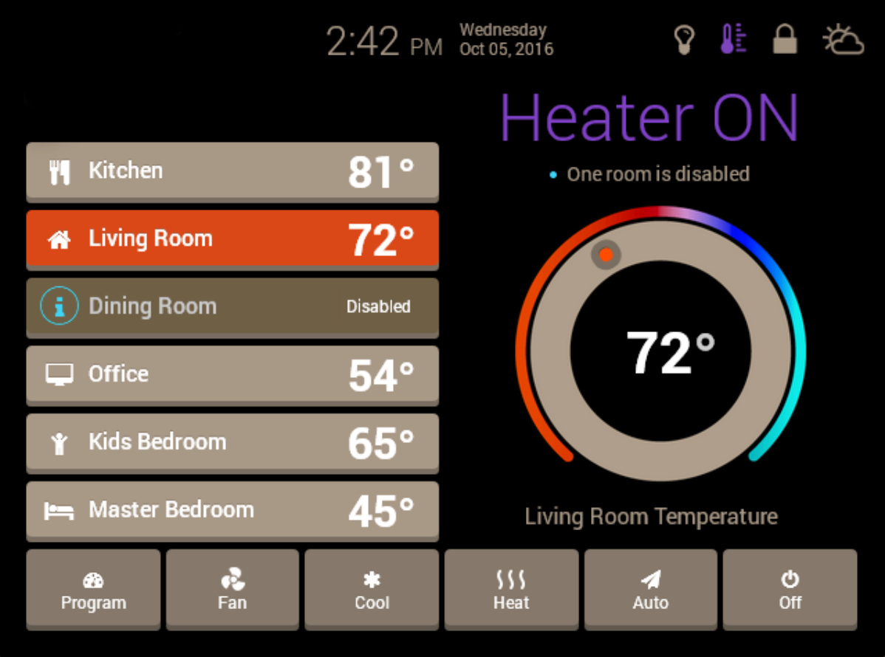
User Interfaces

Slide 20
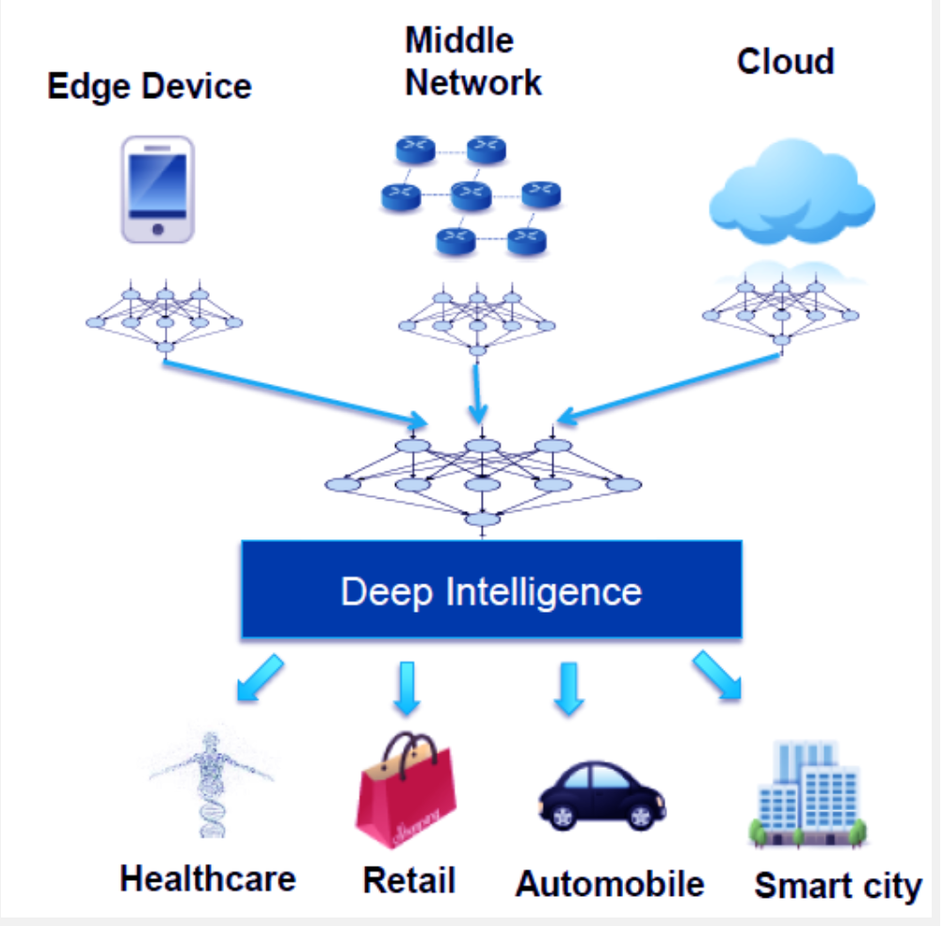

IoT with Big Data & AI

Slide 21
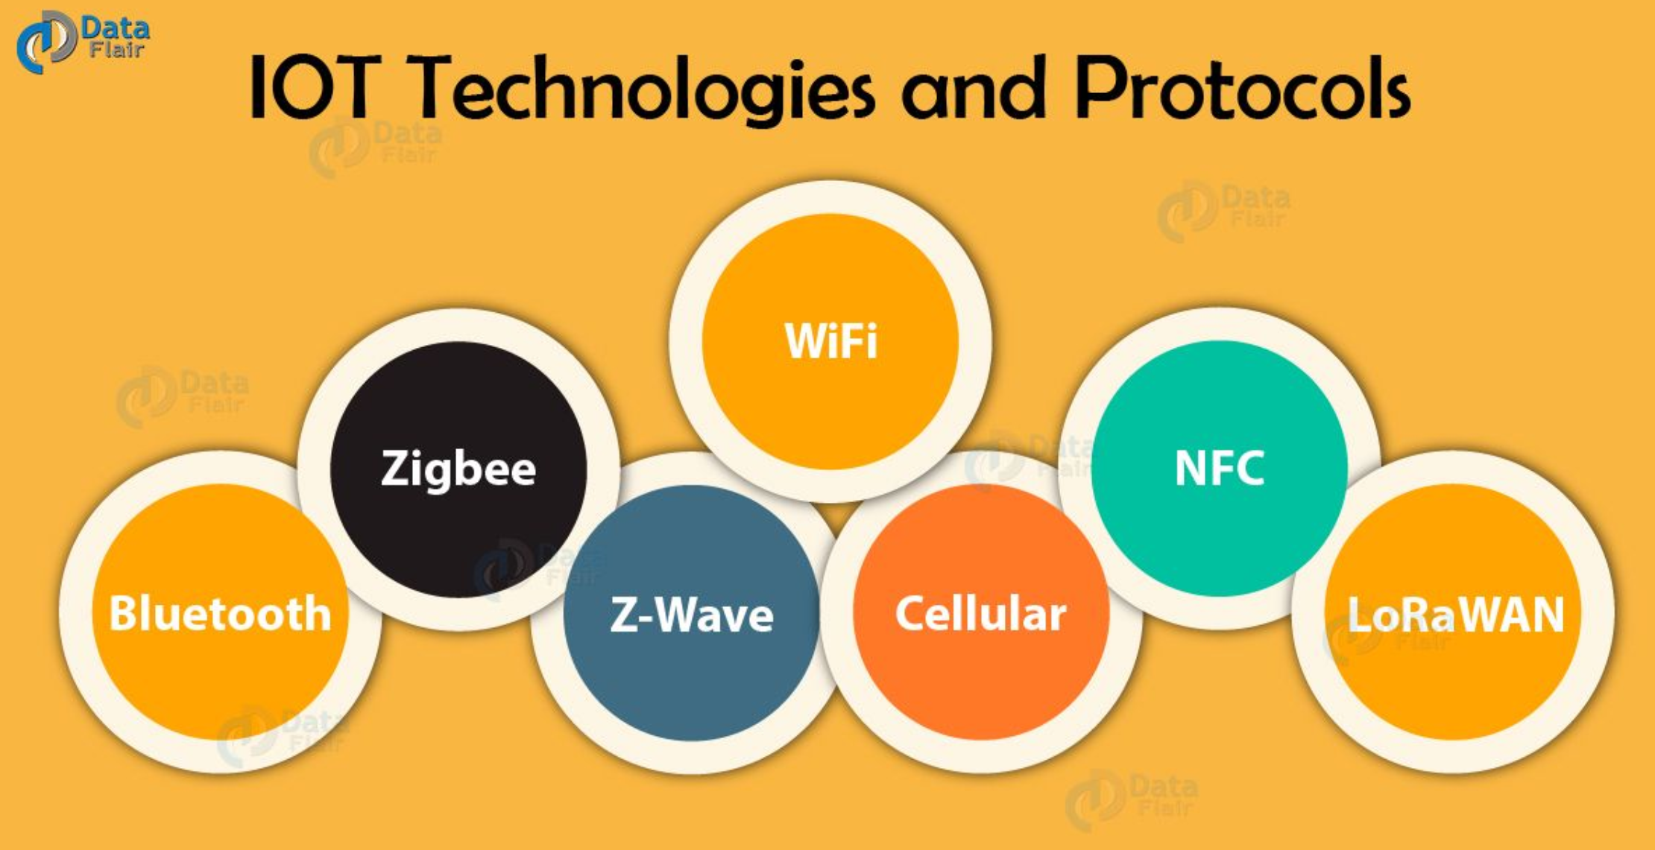
Access Technologies

Slide 22
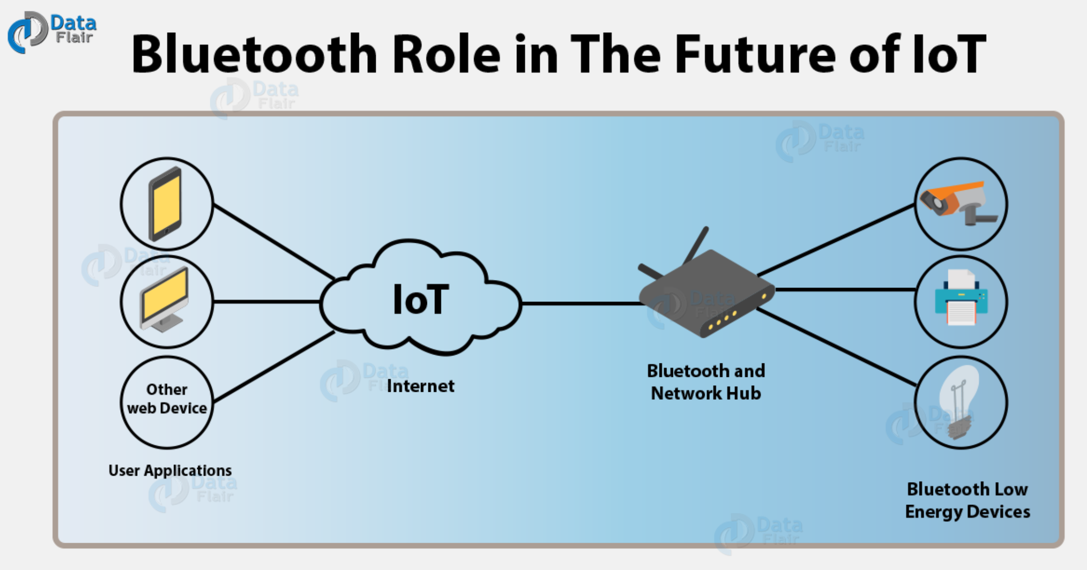
Bluetooth (IEEE 802.15.1)

Slide 23
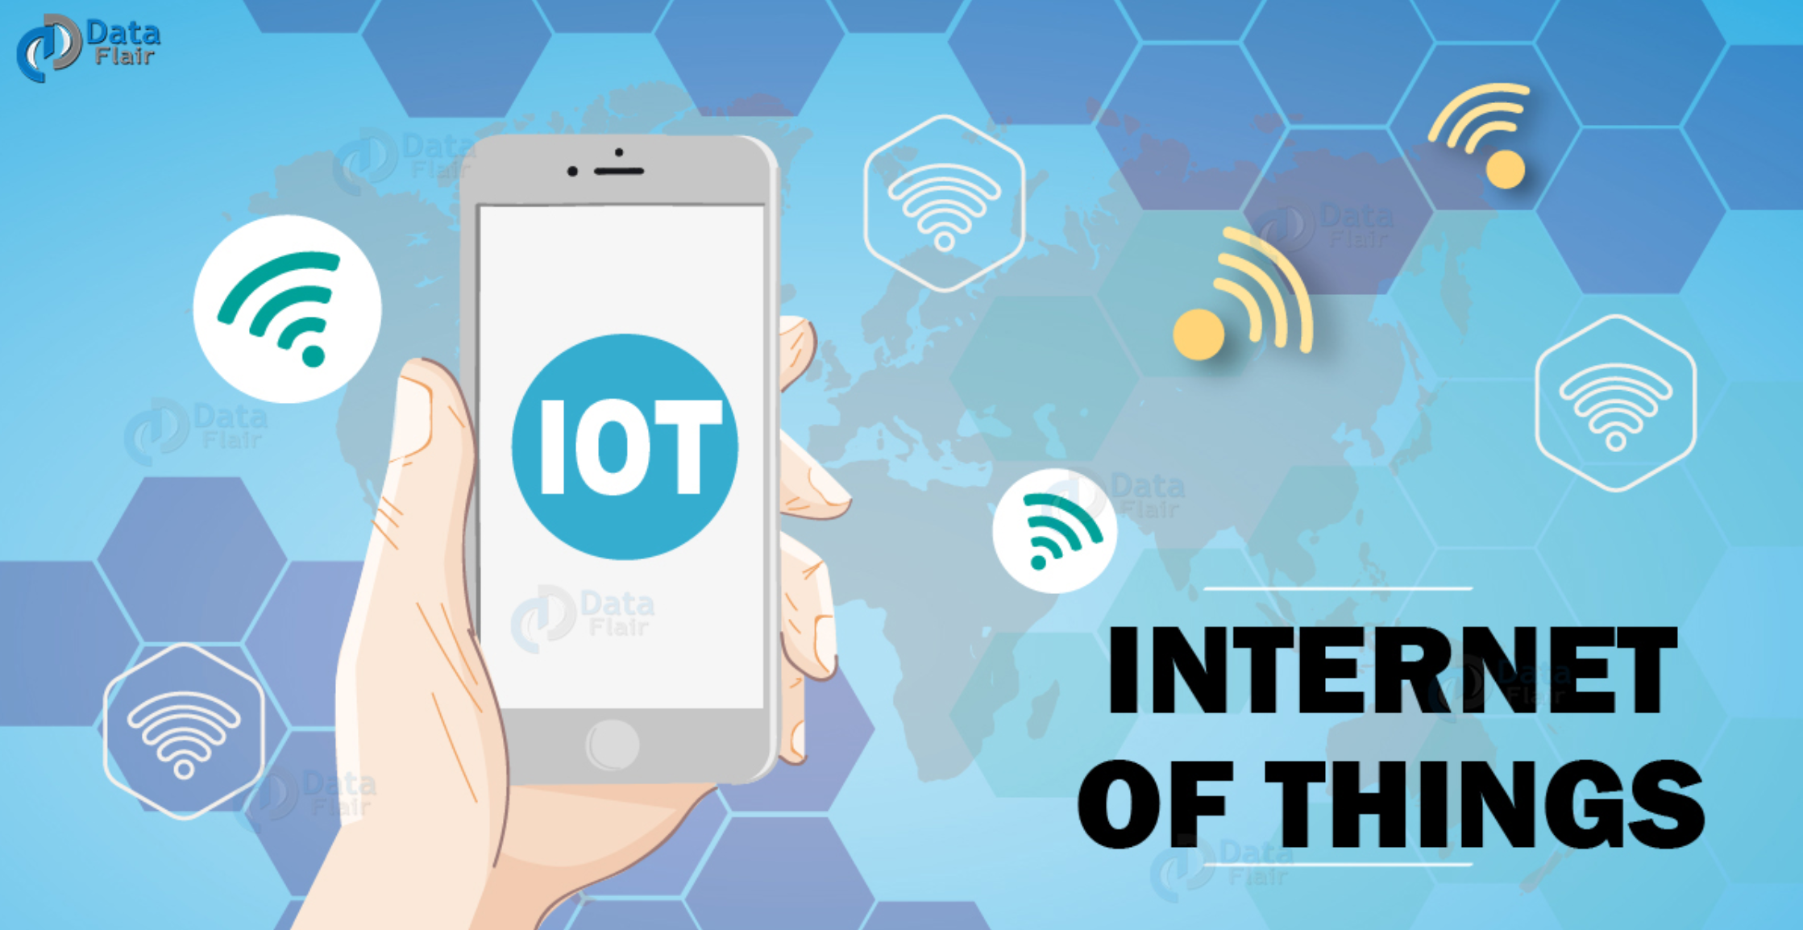
Wi-Fi (IEEE 802.11)

Slide 24
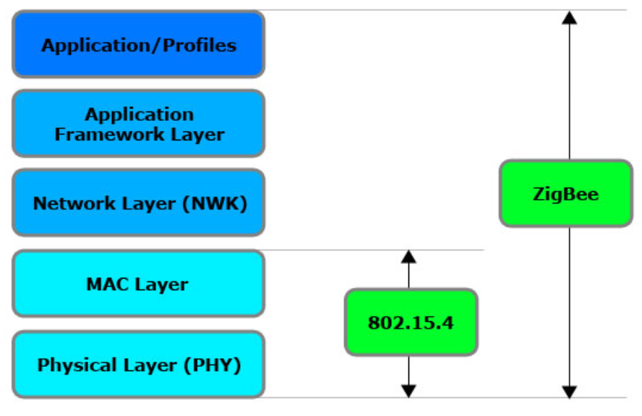
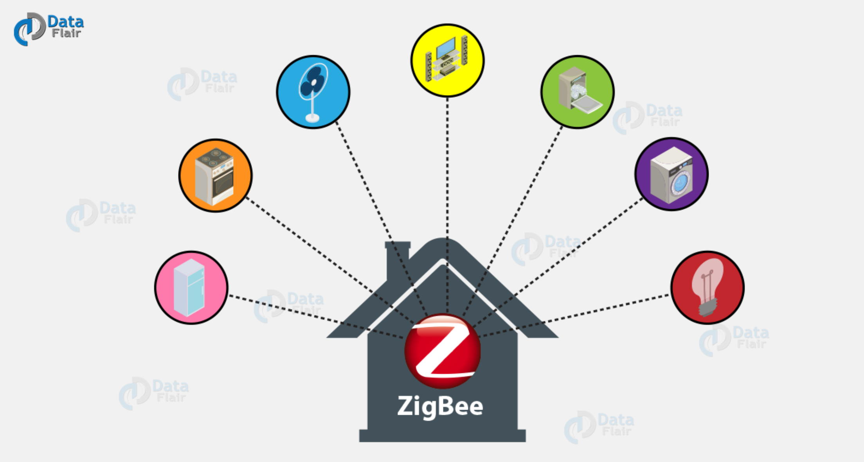
ZigBee (IEEE 802.15.4)

Slide 25
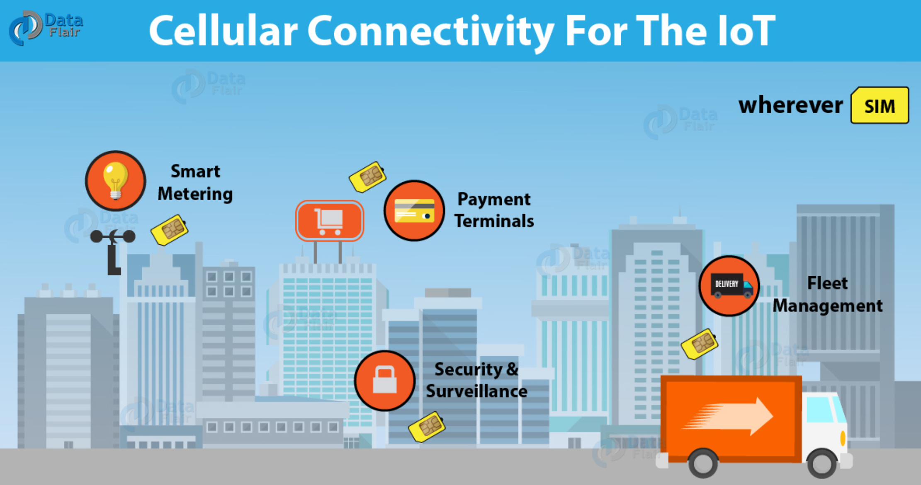
Cellular/LTE/5G (3GPP)

Slide 26

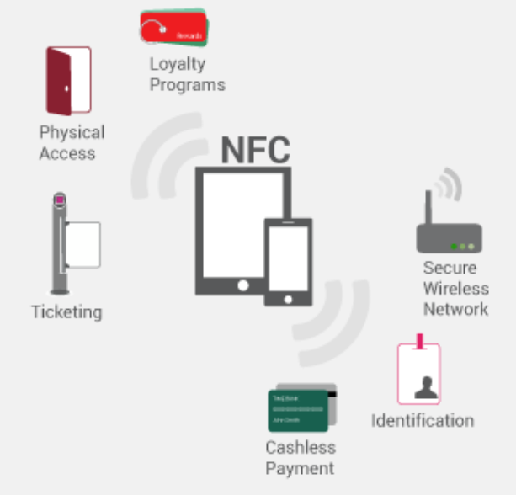
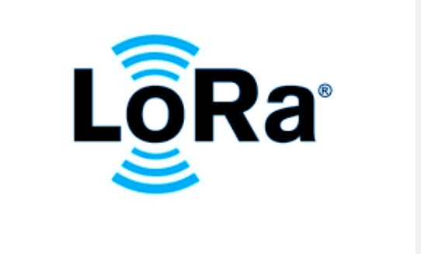
Z-Wave/NFC/LoRaWAN

Slide 27
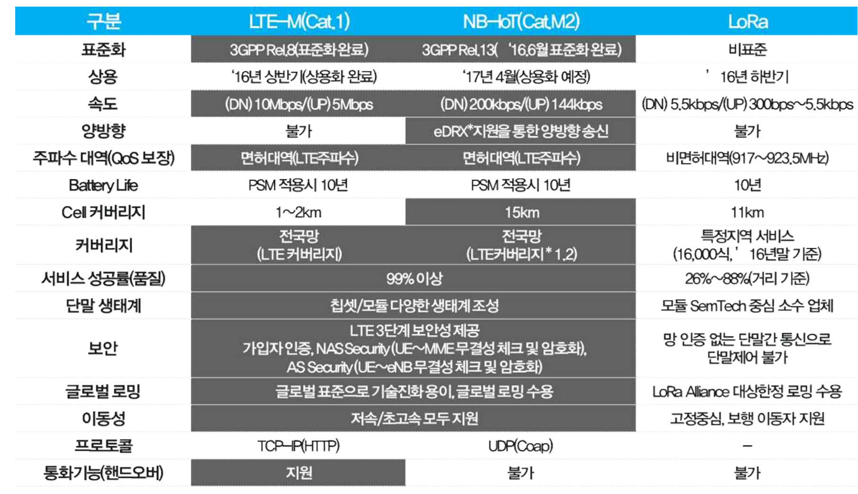
LPWA: LoRa & NB-IoT (3GPP)

Slide 28
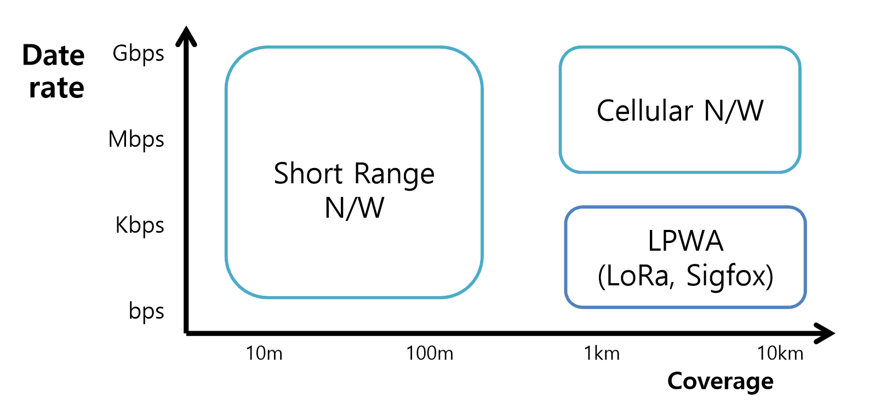
LPWA (Low Power Wide Area)

Slide 29
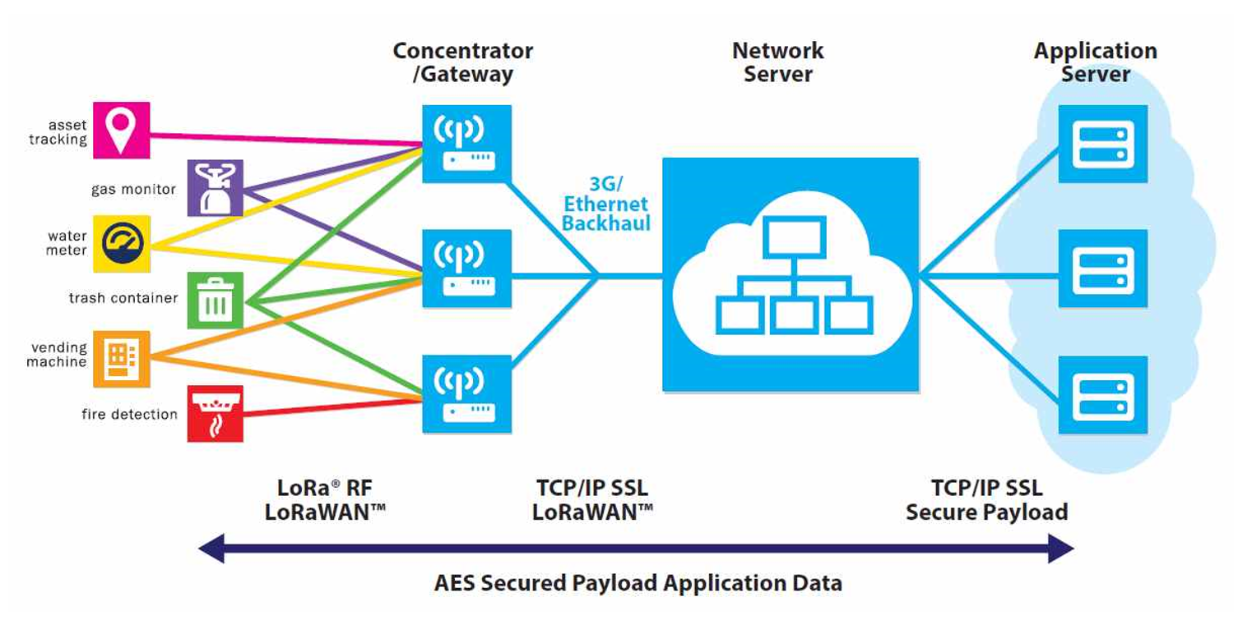
LPWA (LoRaWAN)

Slide 30
IoT Messaging Protocols
HTTP (HyperText Transfer Protocol)
MQTT (Message Queue Telemetry Transport)
CoAP (Constrained Application Protocol)

Slide 31
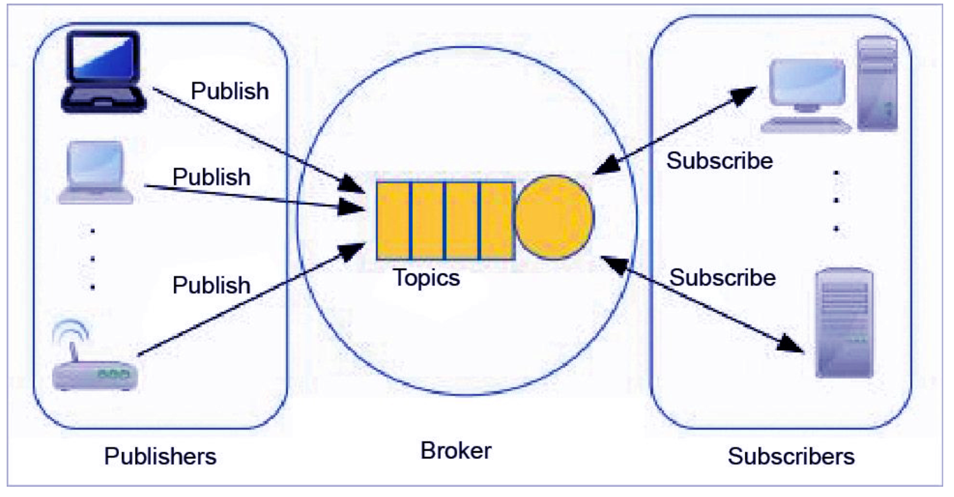
Message Queue Telemetry Transport (MQTT)

Slide 32
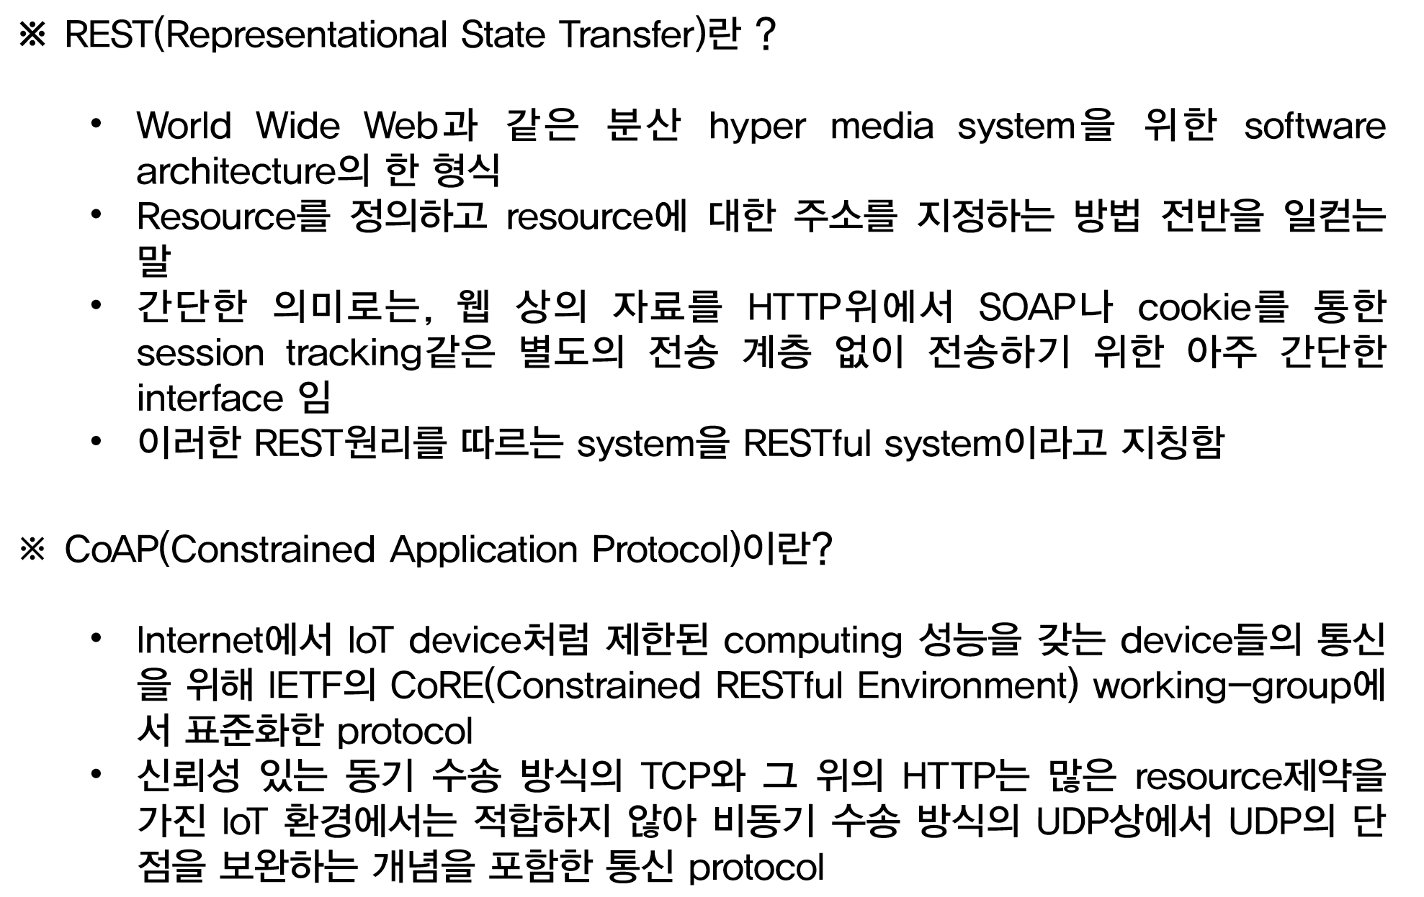
RESTful

Slide 33
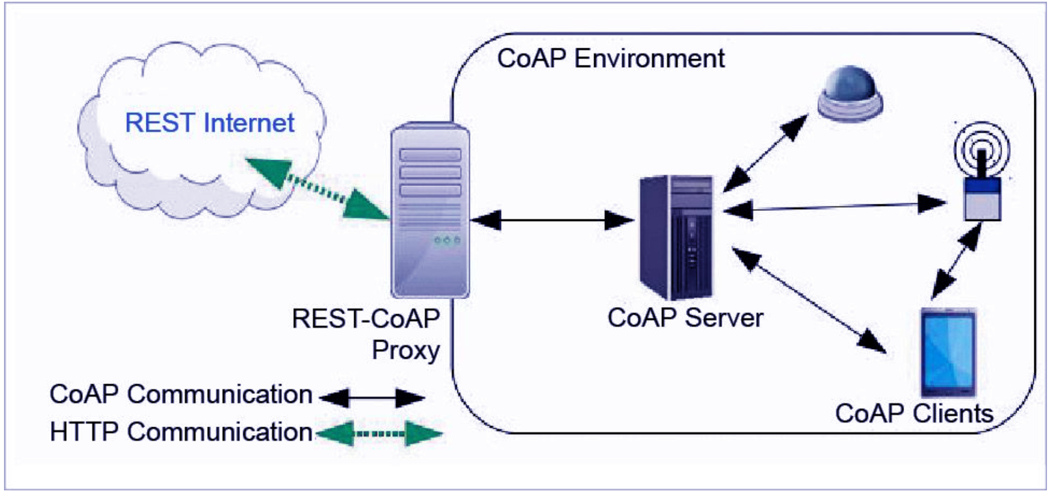
Constrained Application Protocol (CoAP)

Slide 34
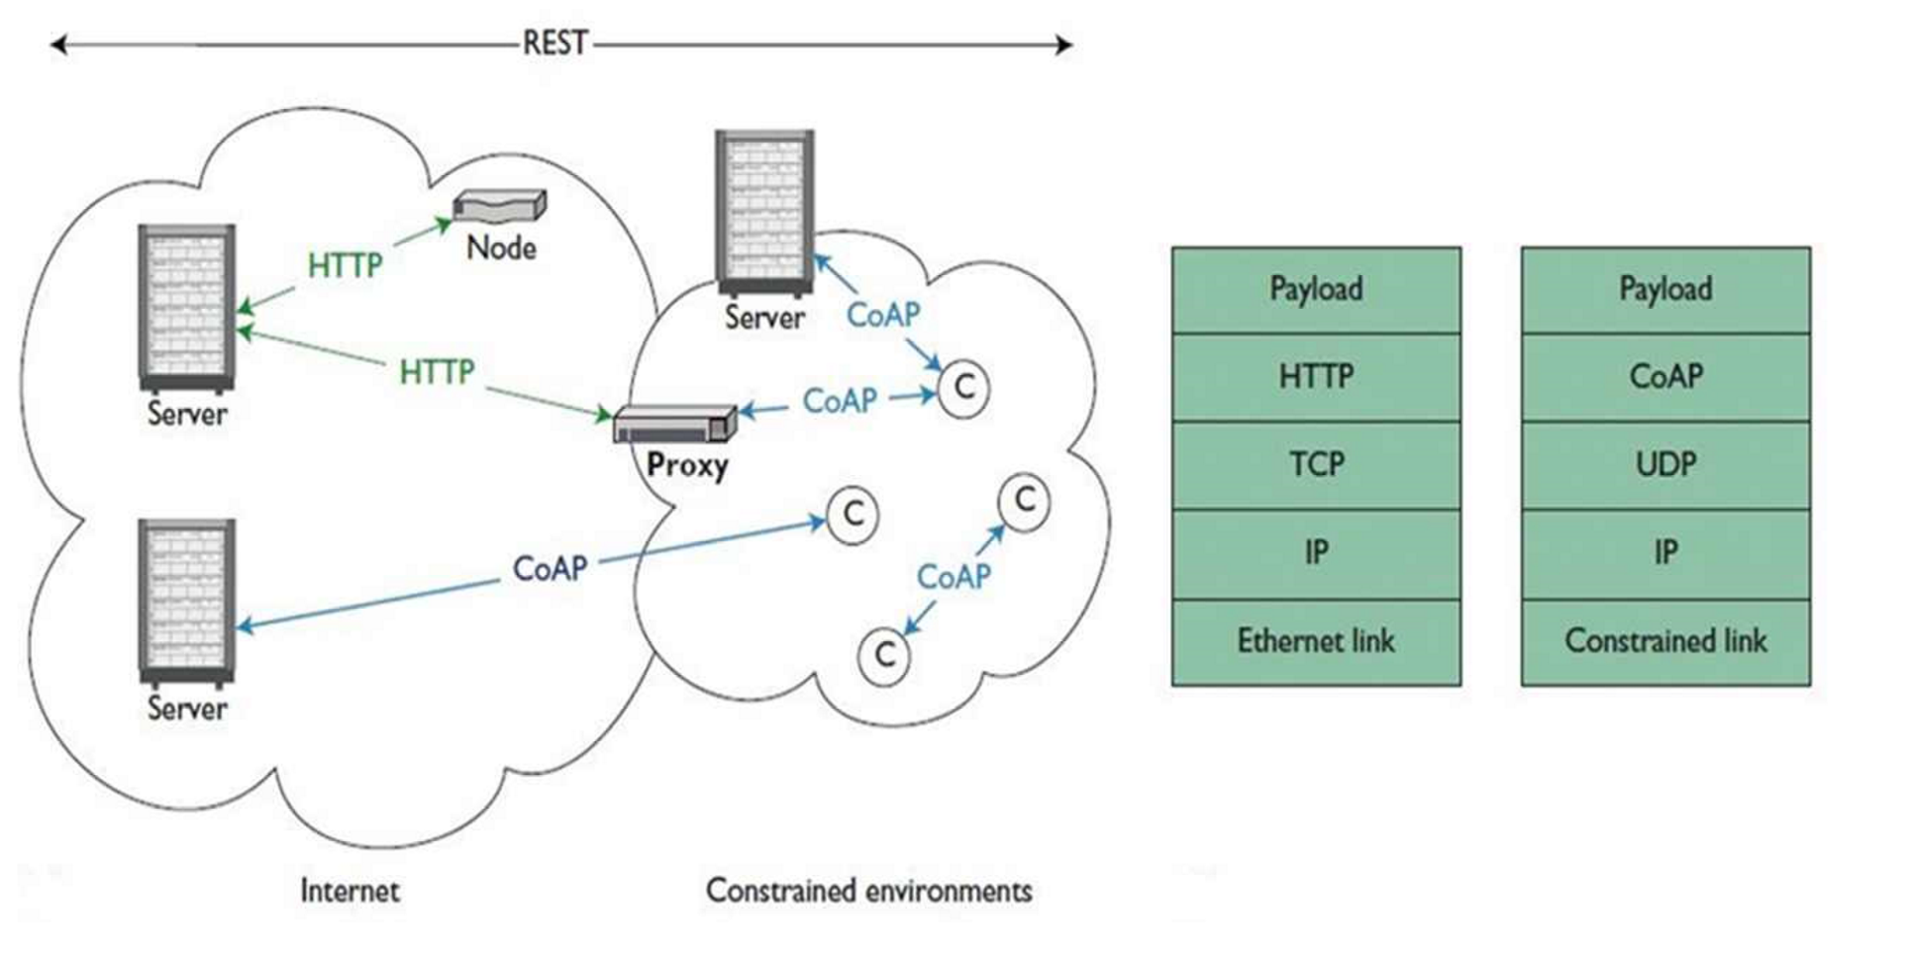
Constrained Application Protocol (CoAP)

Slide 35
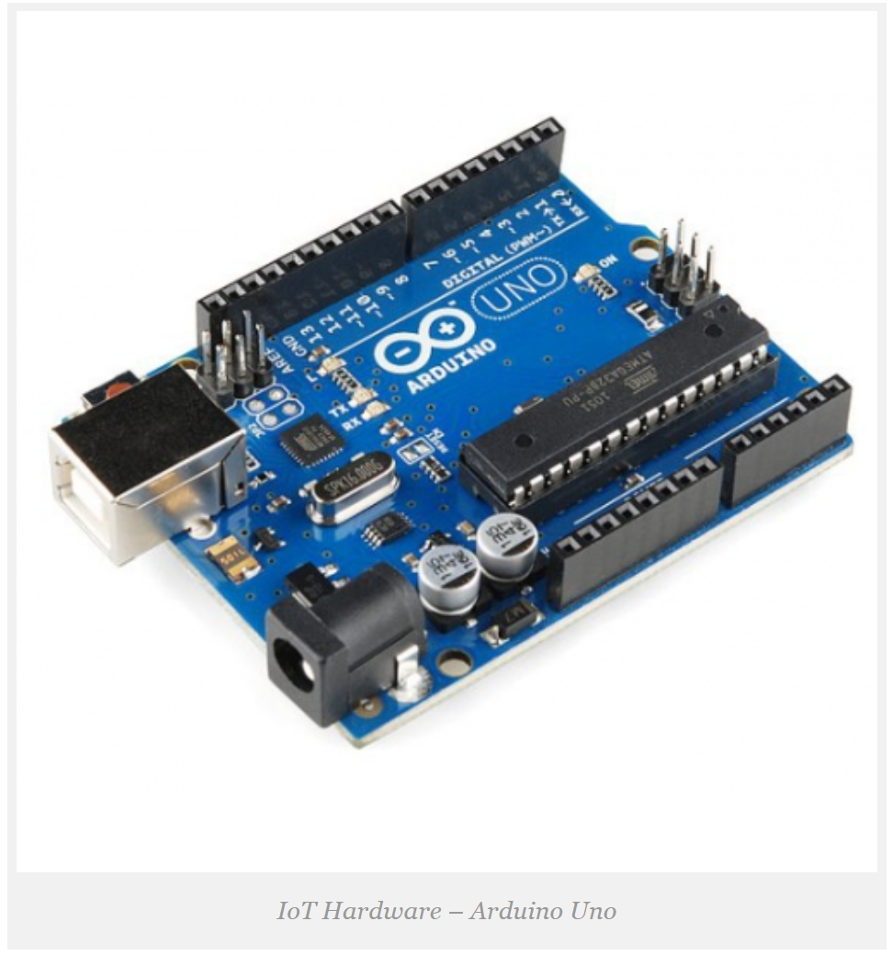
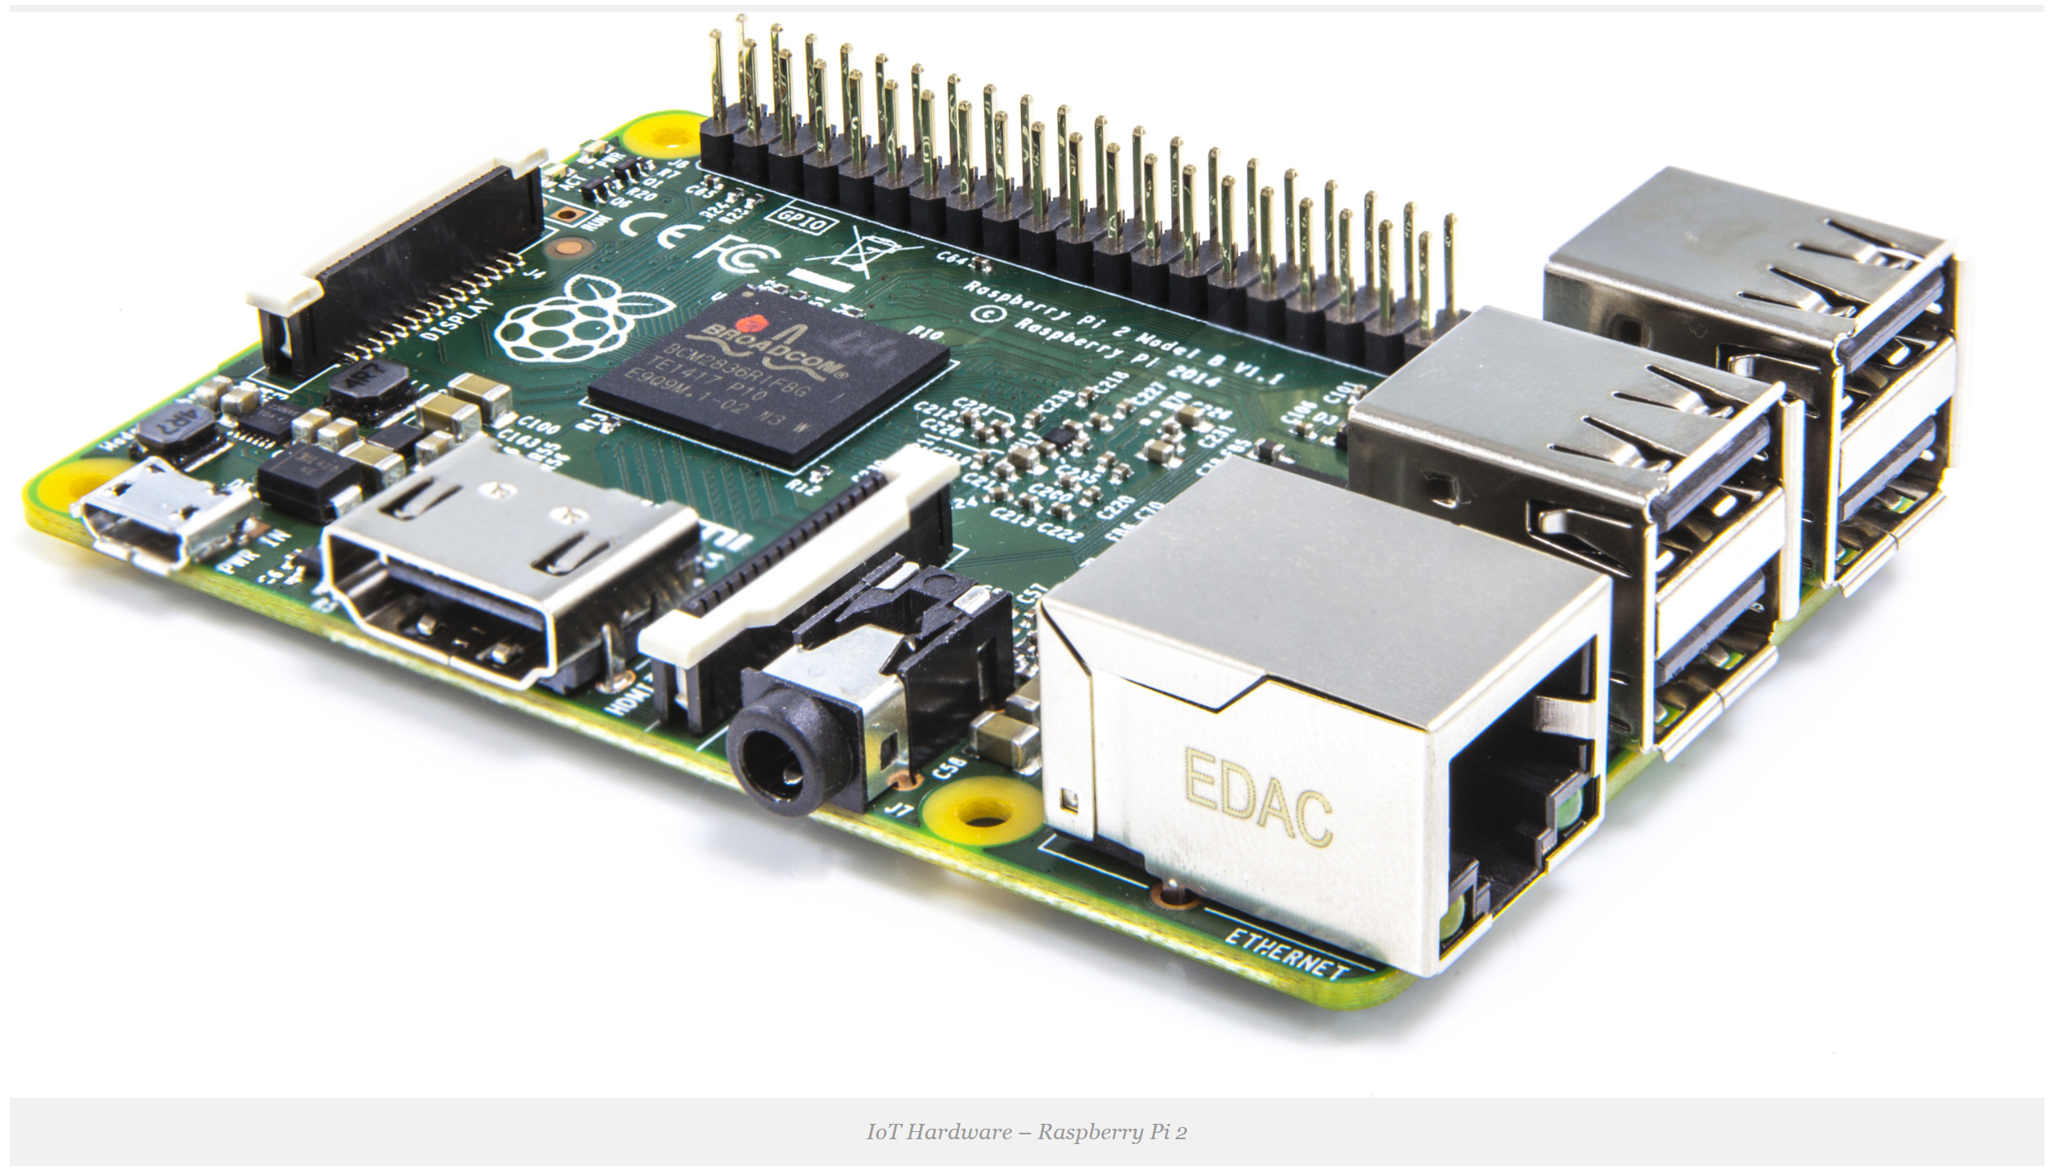
IoT Hardware

Slide 36
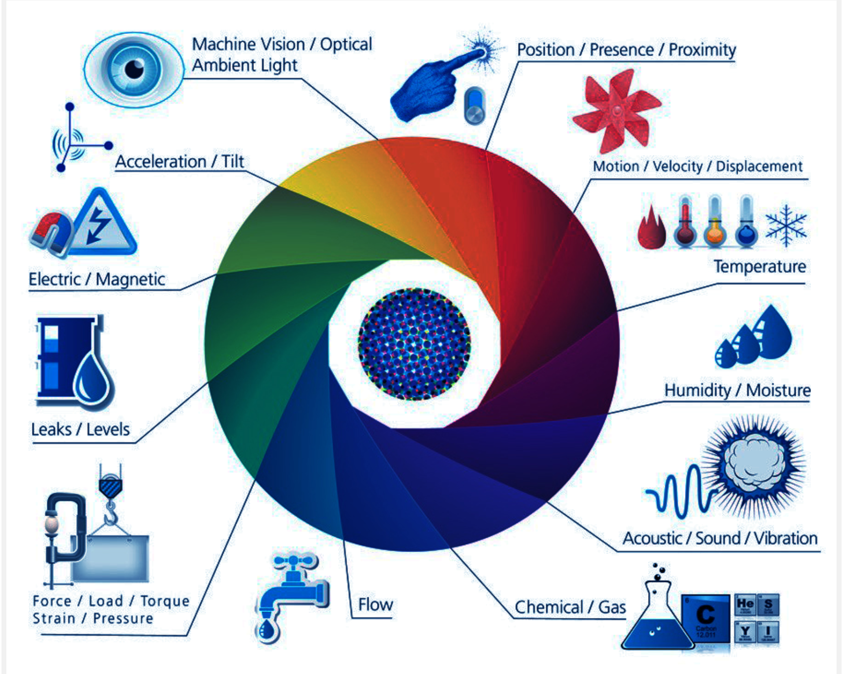
IoT Sensors

Slide 37
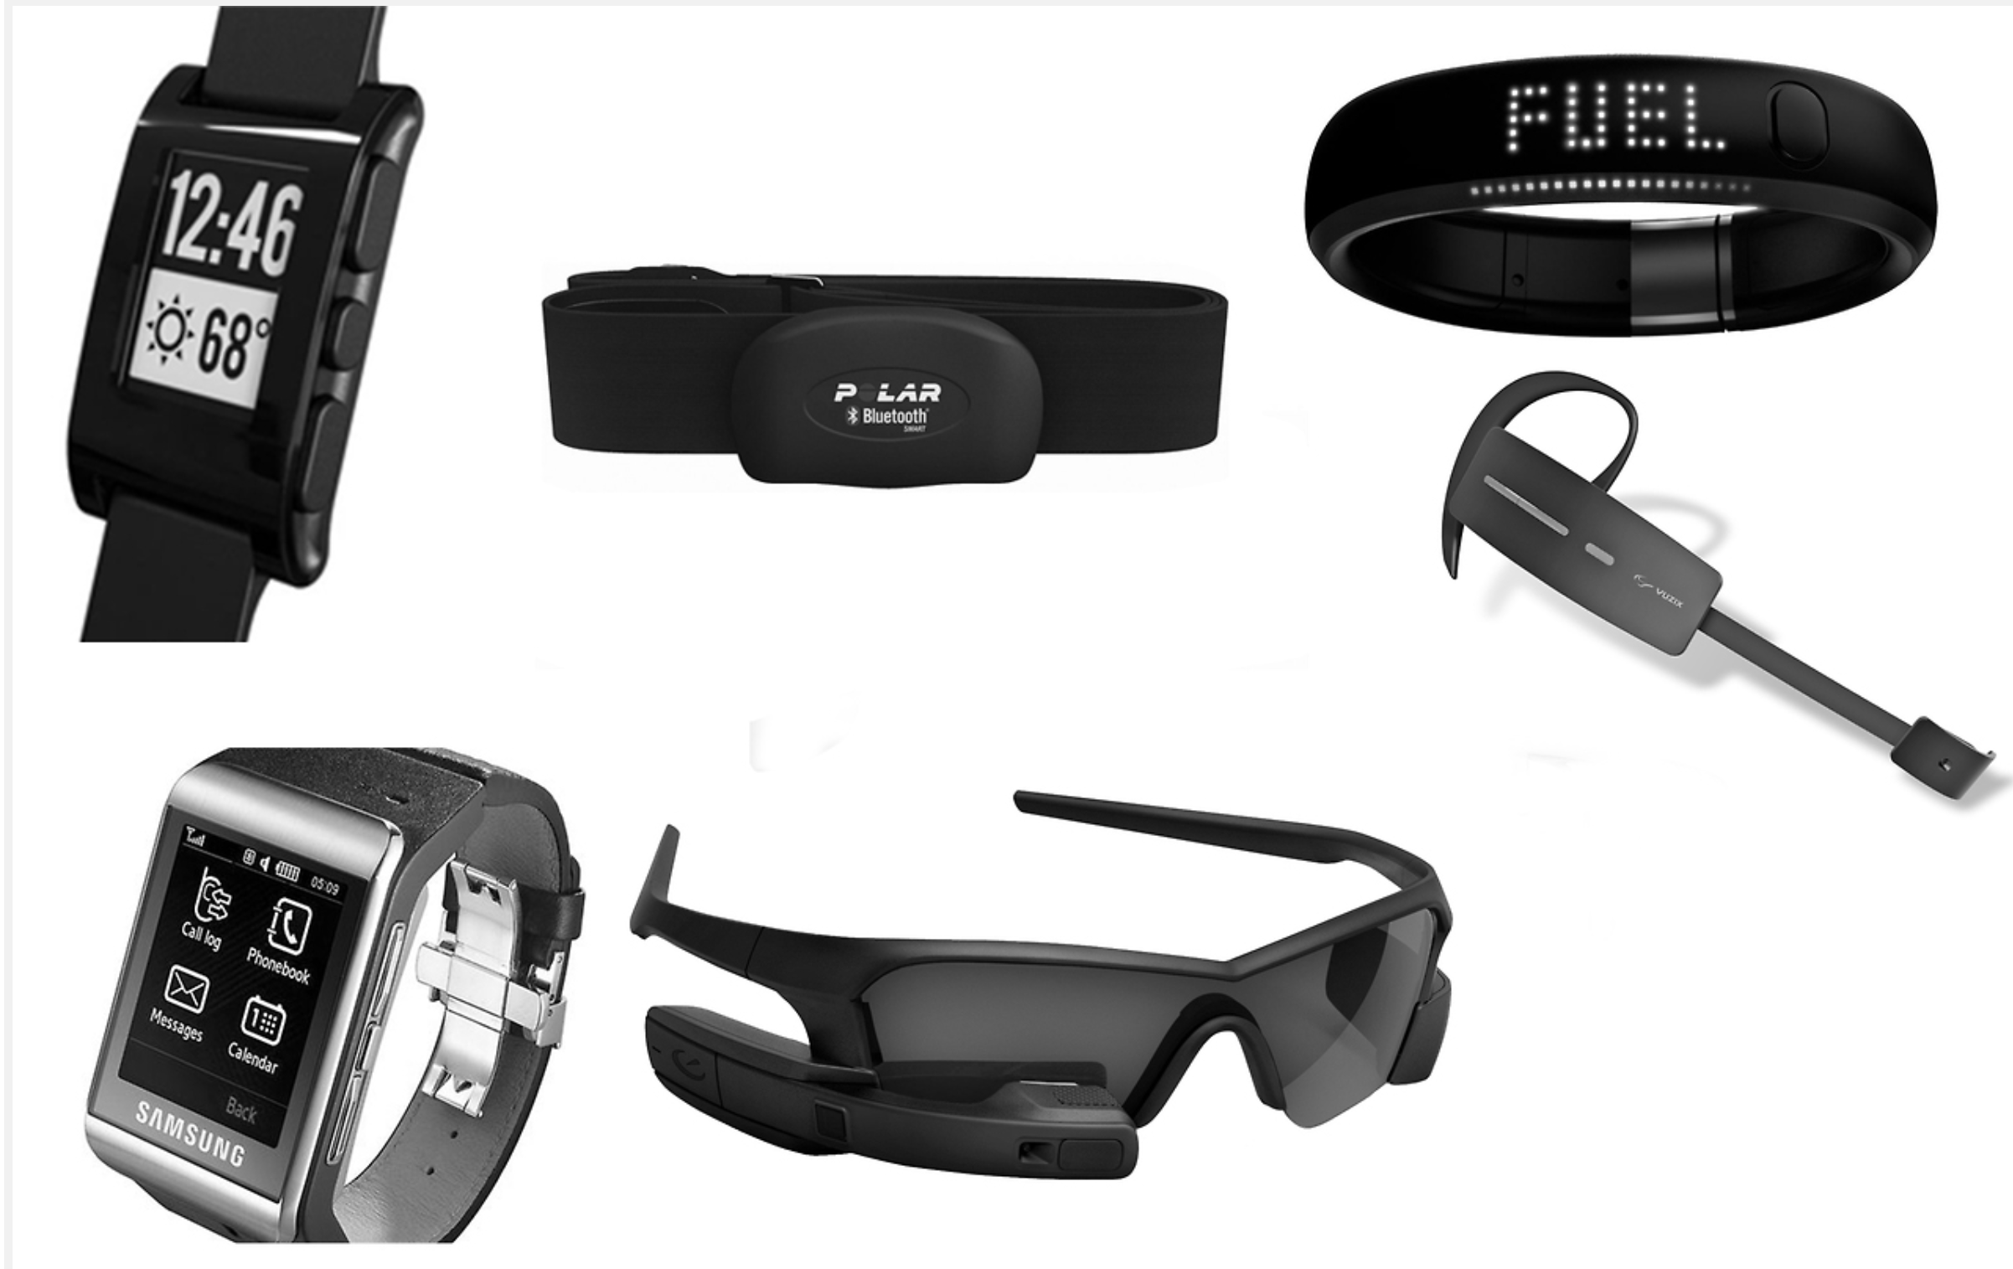
IoT Wearable Devices

Slide 38
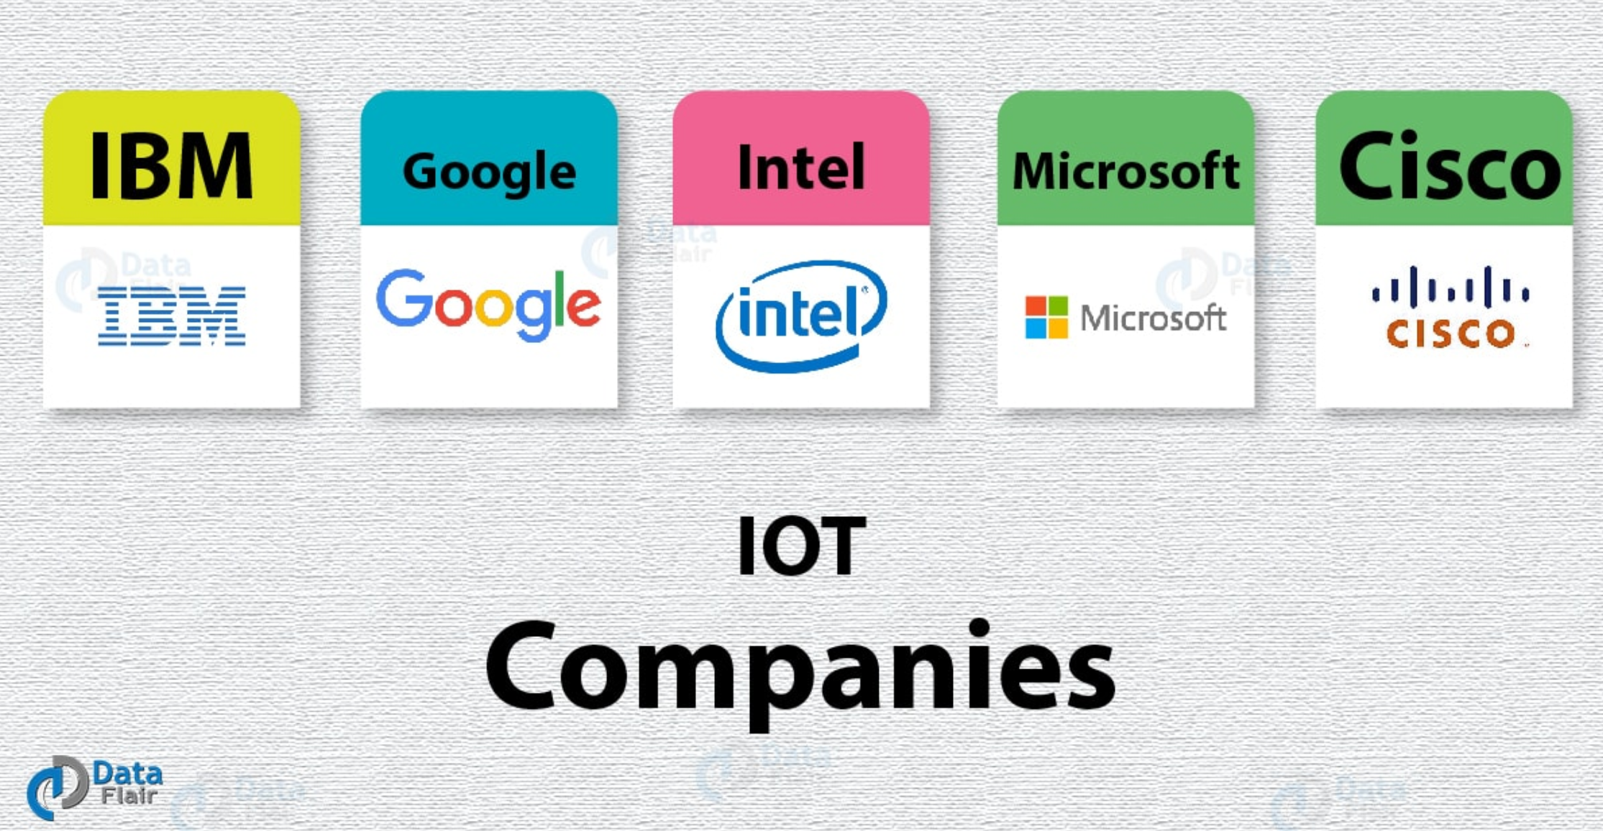
IoT Companies

Slide 39
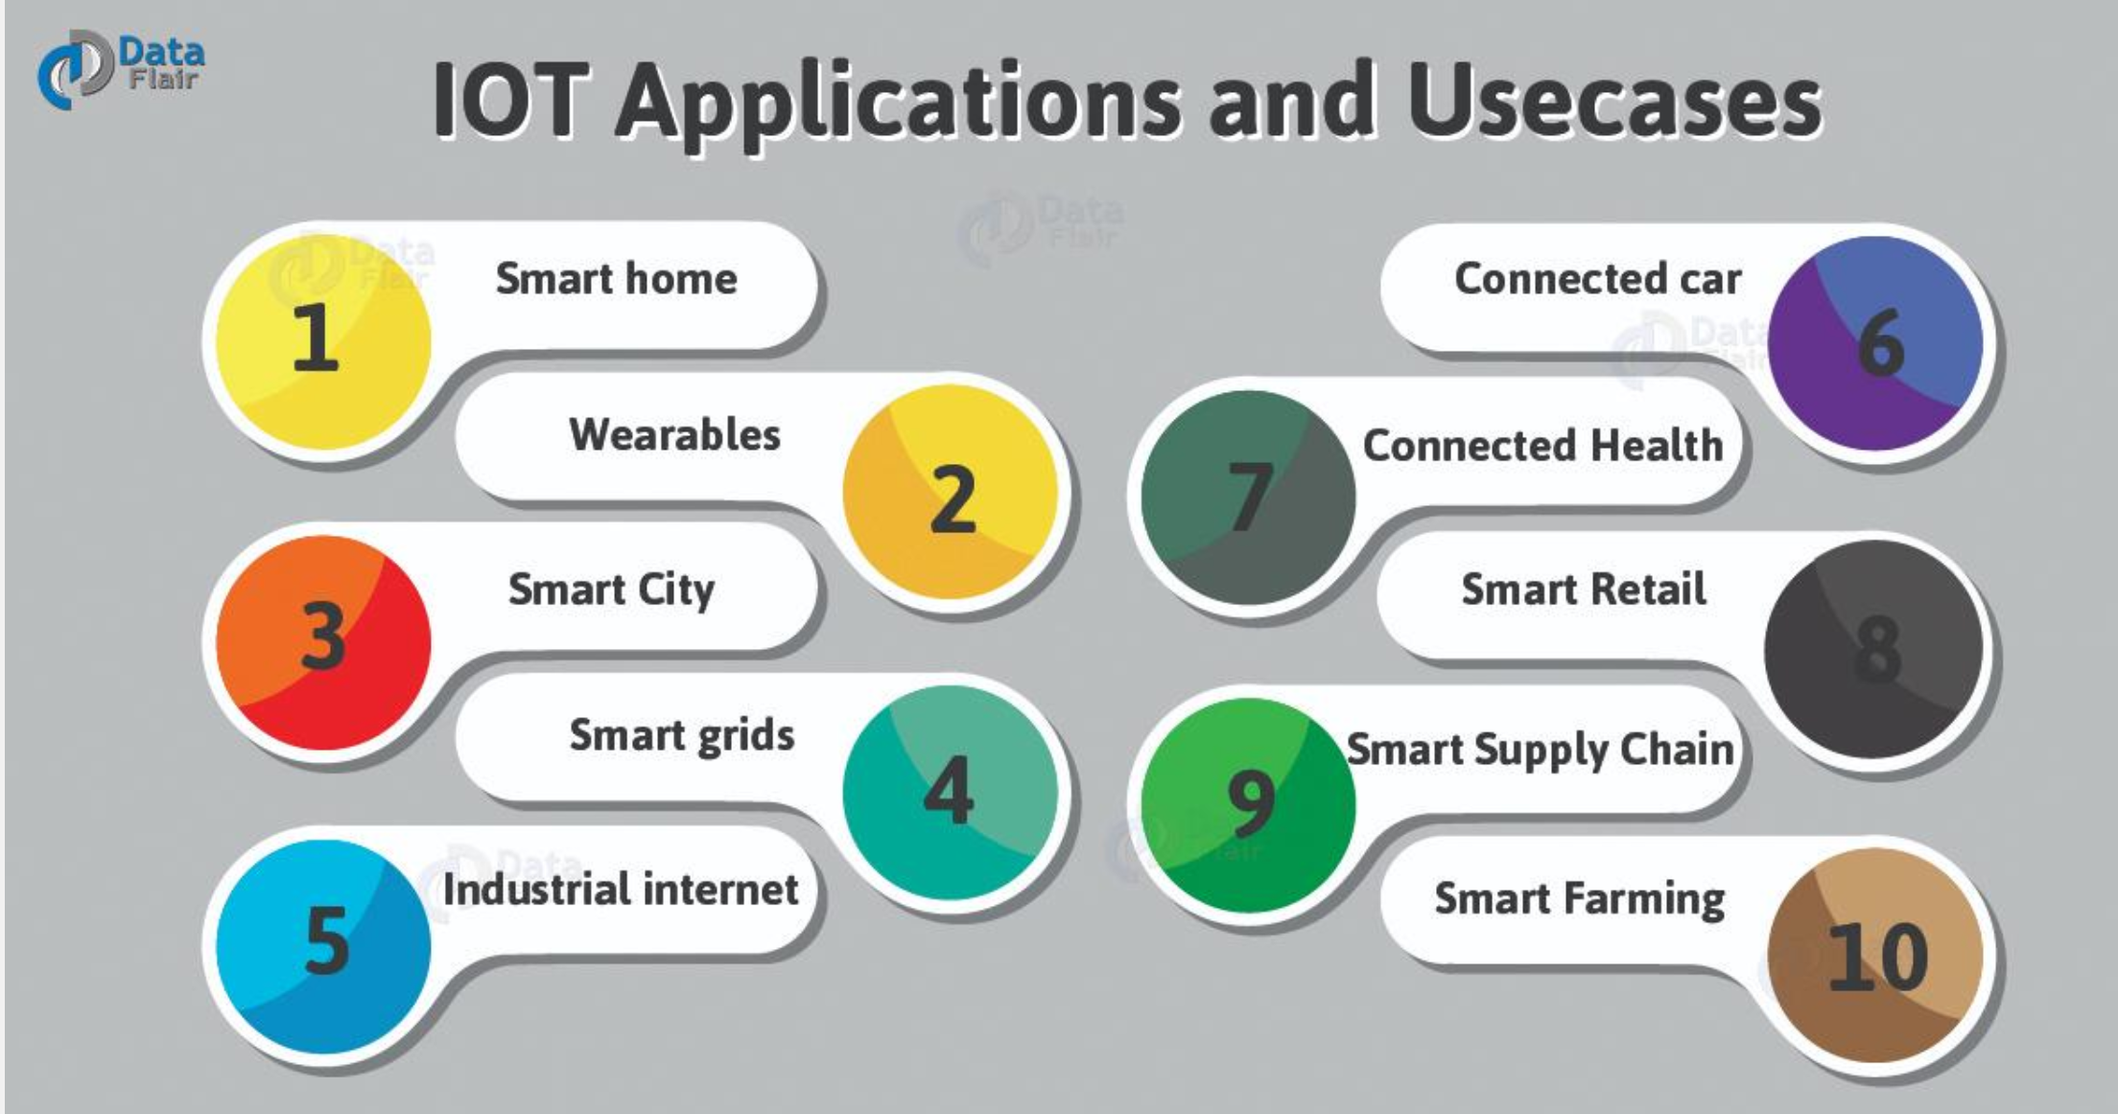

Slide 40
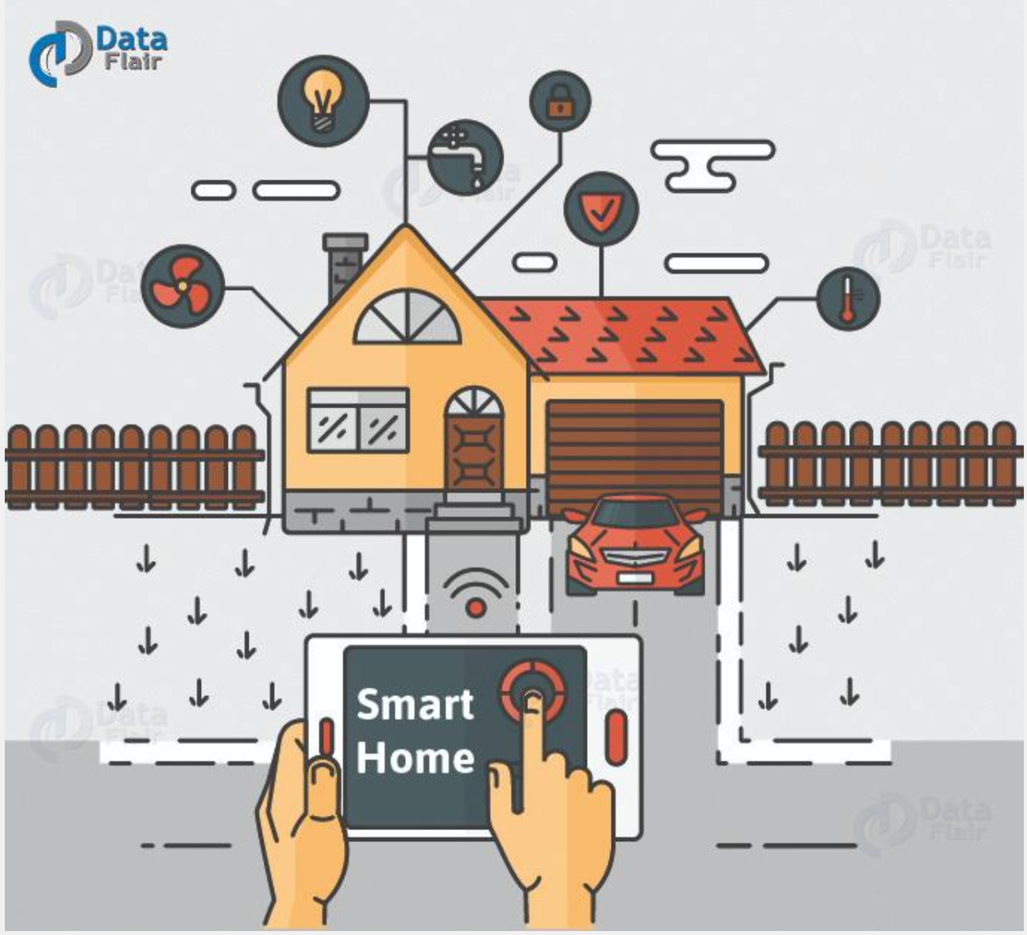
Smart Home

Slide 41

Smart City

Slide 42
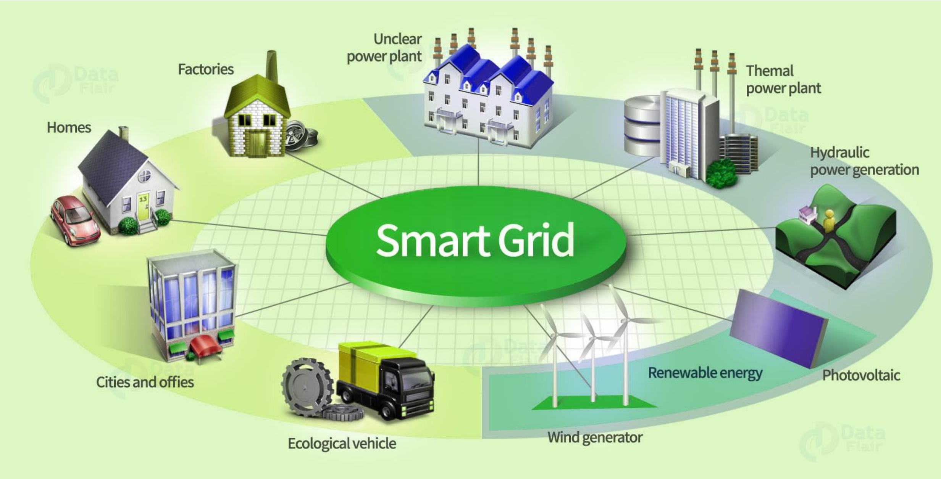
Smart Grid

Slide 43
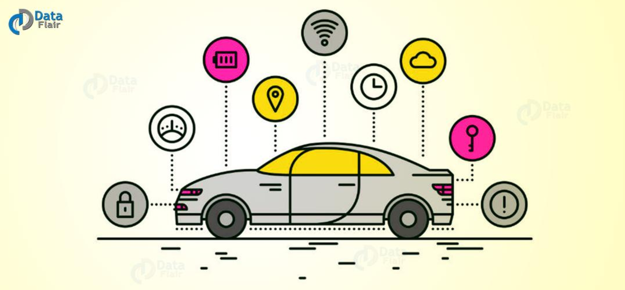
Connected Car

Slide 44
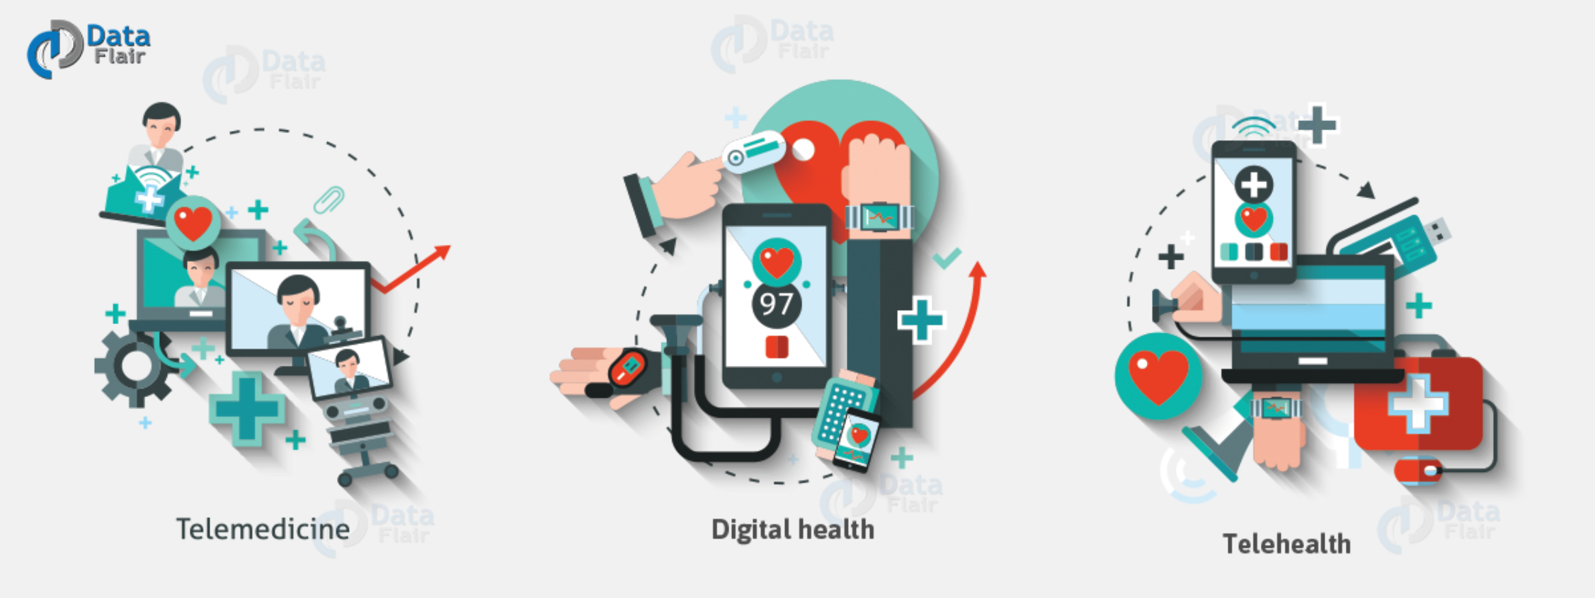
Healthcare

Slide 45
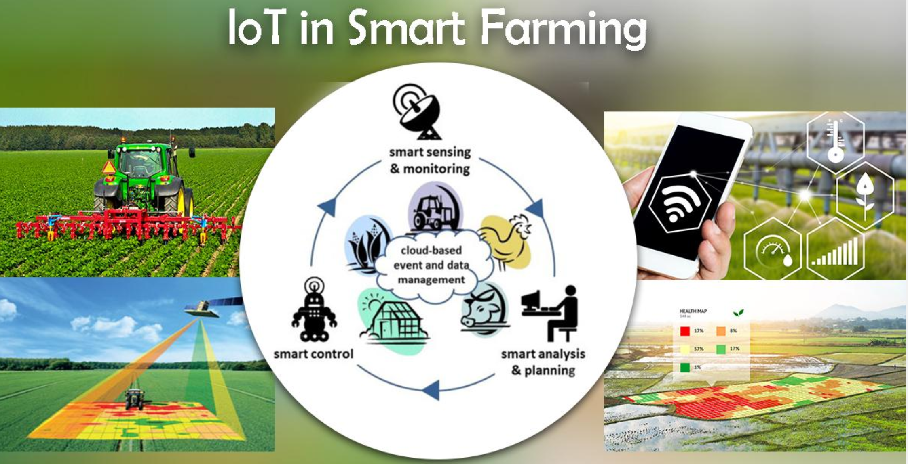
Smart Farm

Slide 46
Thanks for your attention!
Q & A

